Slide 1
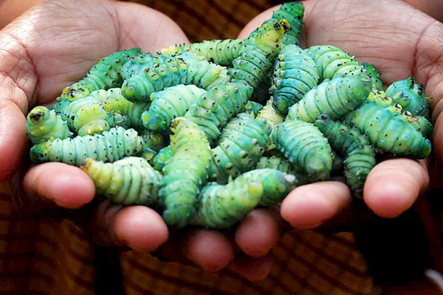
NON-MULBERRY SERICULTURE
Presentation by:
JAYDEEP KUMAR NATH
ASSISTANT PROFESSOR
DEPARTMENT OF ZOOLOGY, SALBARI COLLEGE

Slide 2
What is Sericulture?
Sericulture means cultivation of food plants and rearing of silkworms for production of quality silk.
Sericulture is an agro based cottage industry, which include three main activities
Production of quality seed,
Rearing of Silkworm and raising of cocoons for silk,
Reeling of cocoons and yield of silk.

Slide 3
Sericulture means cultivation of host plants and rearing silkworms which finally produces SILK.
The word silk sounds luxury and class.
Till today, no other fabric can match it in luster and elegance.
As long as human desire for silk garments continues, the demand for sericulture activity remains.
Silk is the queen of textile and the naturally produced animal fibre
Silk is known as BIO STEEL due to strength of it.
China is the world’s largest producer of silk. Though, way behind in quantum of production, the Indian silk industry has some unique features.
India is emerging as a major silk producing country in the world. Among the countries producing silk, India ranks second.

Slide 4
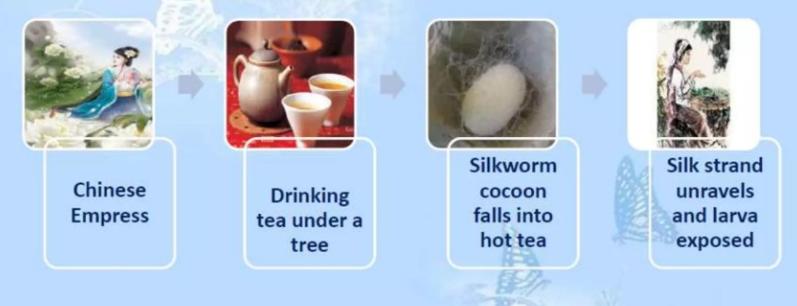
HISTORICAL PERSPECTIVE:
CHINA IS THE ORIGIN OF SERICULTURE.
CHINESE LADY NAMED HSI-LING-SHIH INVENTED MYSTERY OF SILKWORM COCOONS ACCIDENTALY.
She was drinking tea under tree, when a silk cocoon fell into her tea cup and the hot tea loosened the long strand of silk.
As she it out, and started to wrap the silk thread around her flinger, she felt the warm sensation.
When silk ran out, an larva appeared. She realized that it was this larva that produces the silk.
Soon, she taught this to people and it became wide spread.

Slide 5
TYPES OF SILK :
SILK TYPE | SILKWORM | HOST PLANT | DISTRIBUTION
Mulberry Silk | Bombyx mori | Morus alba | Europe China USA
Tropical Tasar Silk | Antheraea mylitta | Terminalia tomentosa T. Arjuna( Arjun) | Tropical forest zone ranging from Bihar , Jharkhand to Karnataka
Temperate Tasar Silk | Antheraea pernyi | Quercus serrata | Sub Himalayan region and north eastern India
Eri Silk or Errandi Silk | Philosamia ricini | Castor, Tapioca | Assam and eastern Parts of India
Muga Silk | Antheraea assamensis | Som , Sualu | Brahmaputra Valley

Slide 6
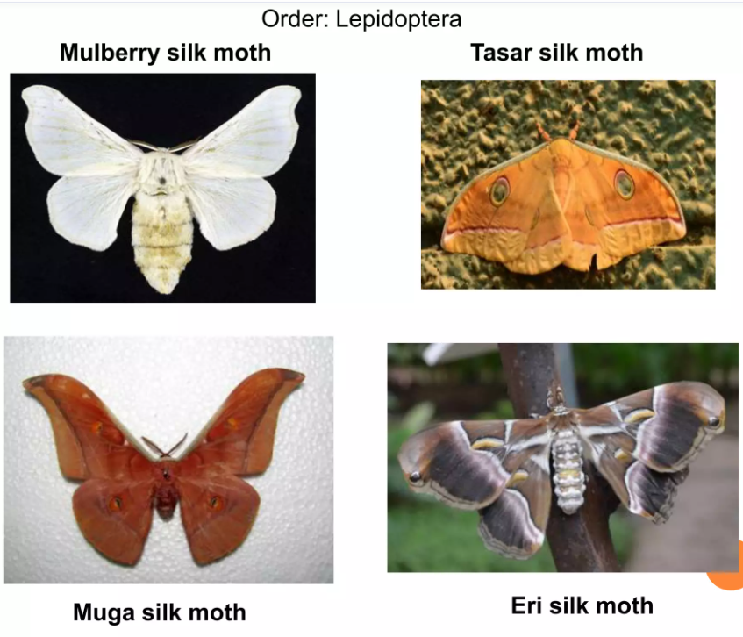

Slide 7
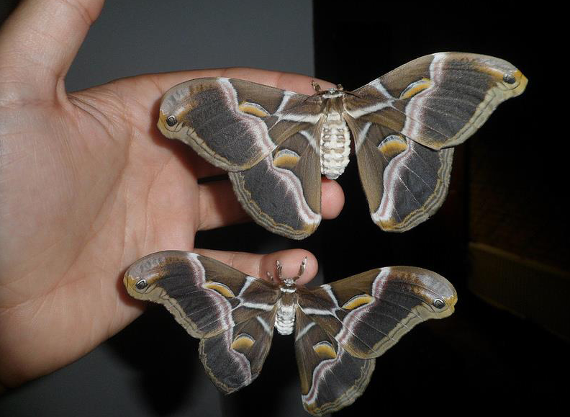
LIFE CYCLE OF ERI SILKWORM:
Philosamia ricini
Top ( Female)
Buttom ( Male )

Slide 8
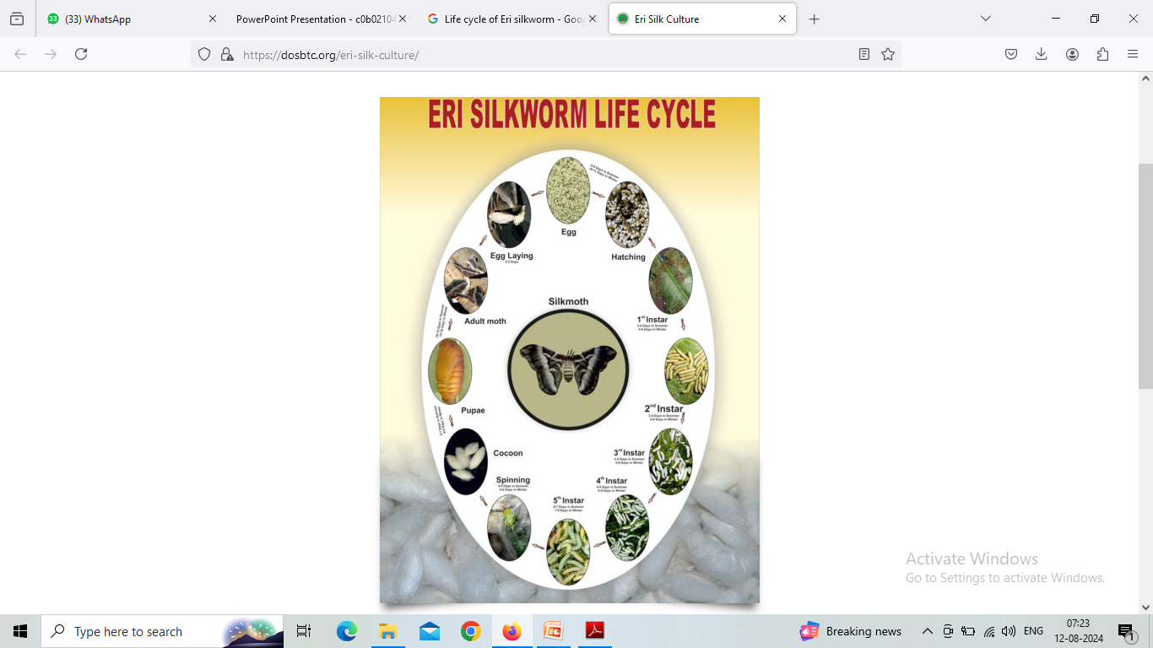

Slide 9
INTRODUCTION
Eri silkworm, Philosamia ricini is multivolitine.
The Eri silkworm Philosamia ricini, is also known as Endi or Errandi and it belonging to family saturniidae.
It is one of the commercially exploited silkworm species and can be reared indoors throughout the year to produce silk.
The silk produced by Philosamia ricini is called Eri silk.

Slide 10
The Ricini moth has a brown wing colour in different shades of brown and has a beautiful black stripe along the wings.
They also have yellow spot and lines on the wings. At the tip of the wings is a small eye spot meant to distract predators.
The body of the moth is white with brown stripes.
The male moth smaller than the female moth and bear bushy antennae and smaller abdomen.
The moths are nocturnal in habit.

Slide 11
FOOD PLANTS OF ERI SILKWORM :
Eri silkworm is a polyphagus insect and feeds on the leaves of several food plant viz,
Castor
Tapioca
Wild castor
Papaya
Barkesseru
Kesseru etc.
Although, Eri silkworm is known to feed on the leaves of more than 30 host plant species but among them Castor is considered as the principal host plant.

Slide 12
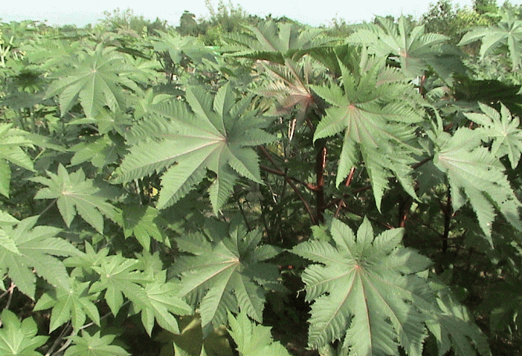
Castor leaves

Slide 13
LIFE CYCLE :
The life cycle of Philosamia ricini, is completed through
(a) eggs
(b) larva
(c) pupa in cocoon
(d) adult moth
In summer, the life cycle is completed in 44-48 days and in winter it takes about 85-87 days.

Slide 14
LIFE CYCLE : EGGS
The eggs are oval shaped with medium size. It is covered by a hard chitinious white coloured shell. The shell colour may be creamy as in wild forms.
The eggs are attached to the surface with one another by colourless glue.
A female moth after copulation lays about 300-500 eggs in cluster. The laying may continue for 3 to 4 days but the eggs of first two days are only kept for rearing.
The hatching of eggs takes place after about 10 days but it depends on the temperature of the environment. The hatching may be delayed upto 14-15 days in winter.
Temperature and humidity play important role in hatching of the eggs.

Slide 15
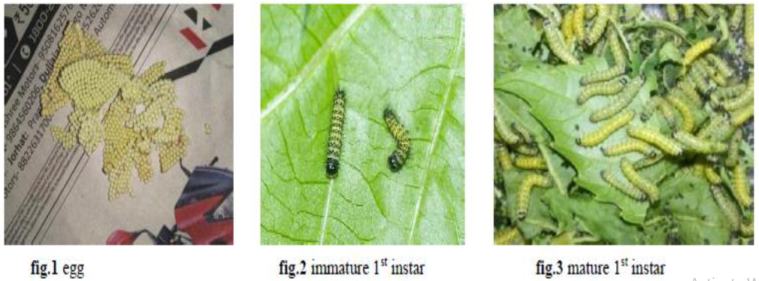

Slide 16
LIFE CYCLE : LARVA
After hatching, the larvae tend to remain together. It is about one centimeter in length.
It grows to a size of 8 centimeters, when mature.
The newly hatched larvae possesses a black coloured head and the body becomes yellow in colour but gradually changed to green yellow.
• The first moult occurs after three days.

Slide 17
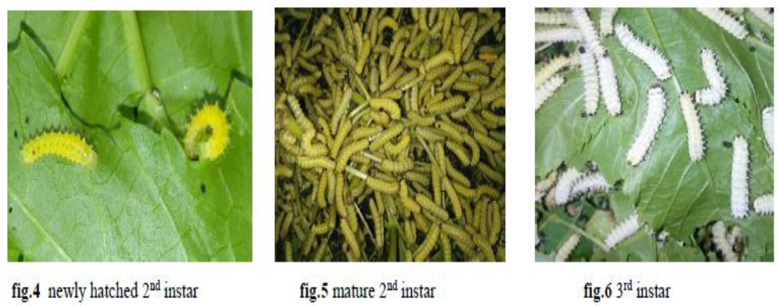

Slide 18
The larva matures in 17 to 45 days depends on the environmental temperature and humidity. During this period, the larva moults four times.
During the onset of moulting, the larva becomes motionless and it does not feed.
On moulting, the integument of the head breaks on the sides and the larva comes out with a new integument.
The larva possesses a long tubular silk glands. This gland is responsible for production of silk.
The silk gland secrets the silky substance to form the cocoon.

Slide 19
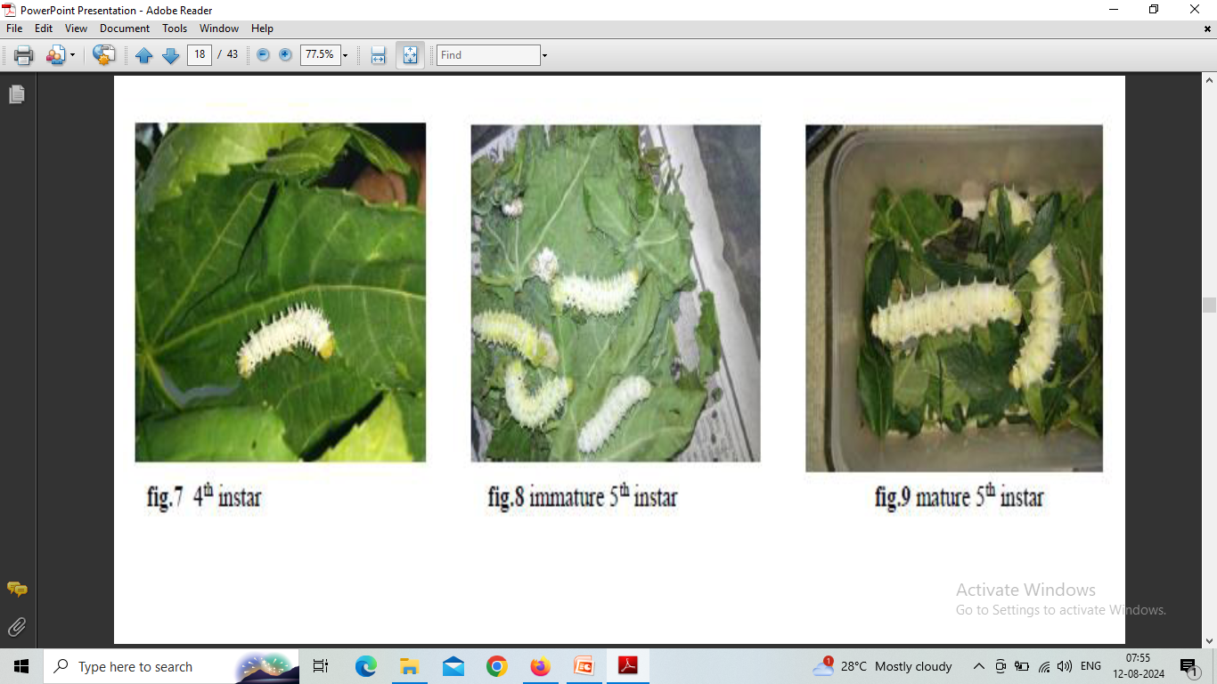

Slide 20
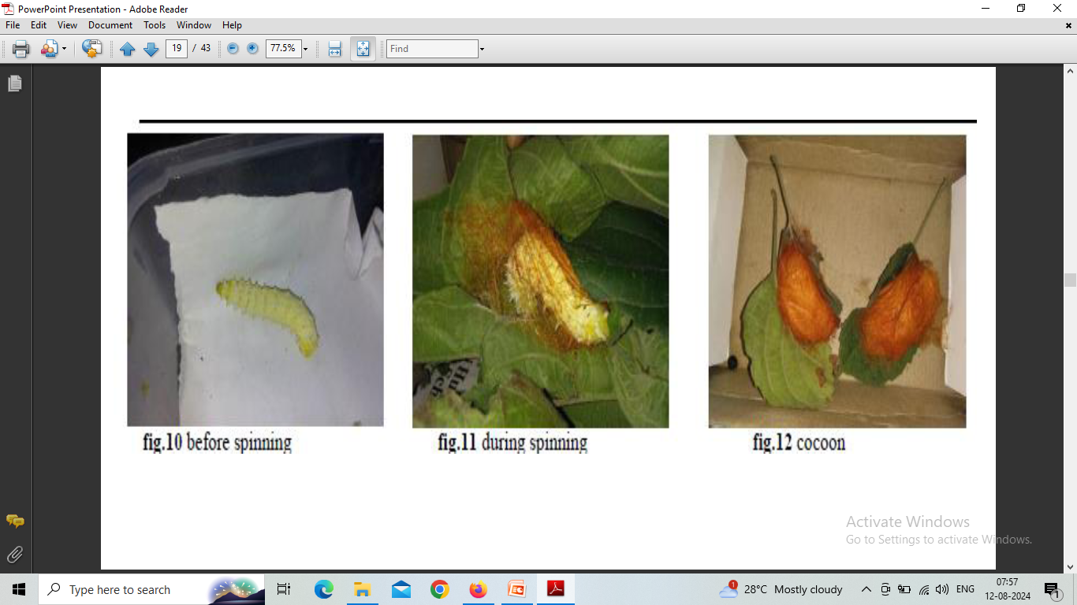

Slide 21
LIFE CYCLE : PUPA
The larva of last instar before moulting ceases feeding and transform into a chrysalid.
The larva excretes silk substance after settling in a crevice and spin the cocoon.
In 3-4 days, the cocoon formation is completed. Inside the cocoon the larva transforms itself into a brown coloured chrysalid.
It is an intermediate form in between the larva and the moth.
The essential organs of the moth are formed. The body is covered by hard integument. It can survive for long time inside the cocoon.
The colour of the chrysalid turns black before the emergence of the moth.

Slide 22
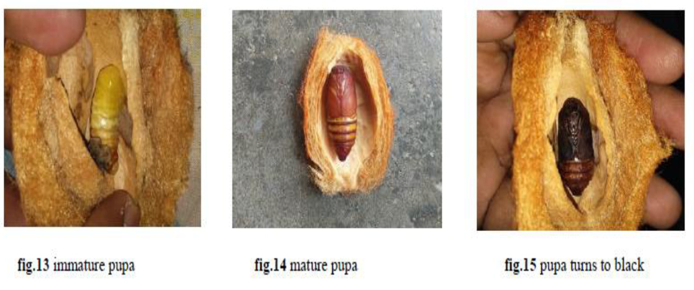

Slide 23
LIFE CYCLE : MOTH
The moth emerges from the chrysalid forms after about 2 weeks.
The moth comes out through the open end of the cocoon.
It emerges normally in morning hours.
As soon as the moth emerges, they secrete some brown liquid which is known as meconium.
The newly hatched male and female moth abdomen has almost same size and their wings remain very soft but after sometime the male abdomen gradually become smaller and they fully stretch their wings which becomes harder.

Slide 24
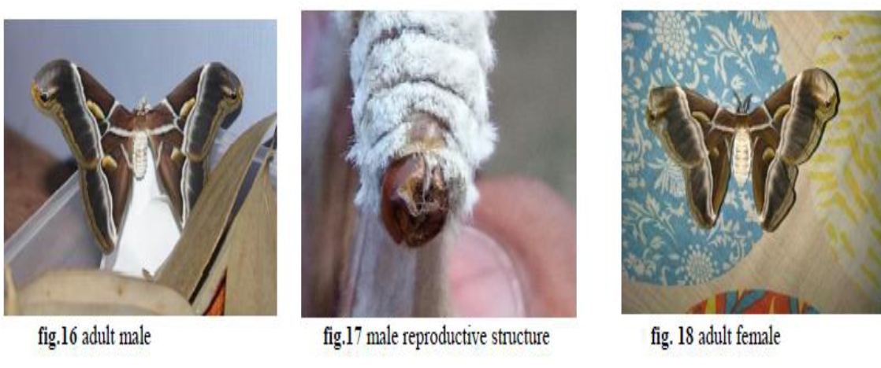

Slide 25
LIFE CYCLE : MOTH
After stretching the wings, the male finds the female for mating which lasts about 24 hours.
During mating the moths remain motionless.
The male unpairs in next evening.
After unpairing, the female lays the eggs normally during the night.
A female moth lays about 300-500 eggs in cluster in 3-4 days.
Life Cycle Continues.

Slide 26
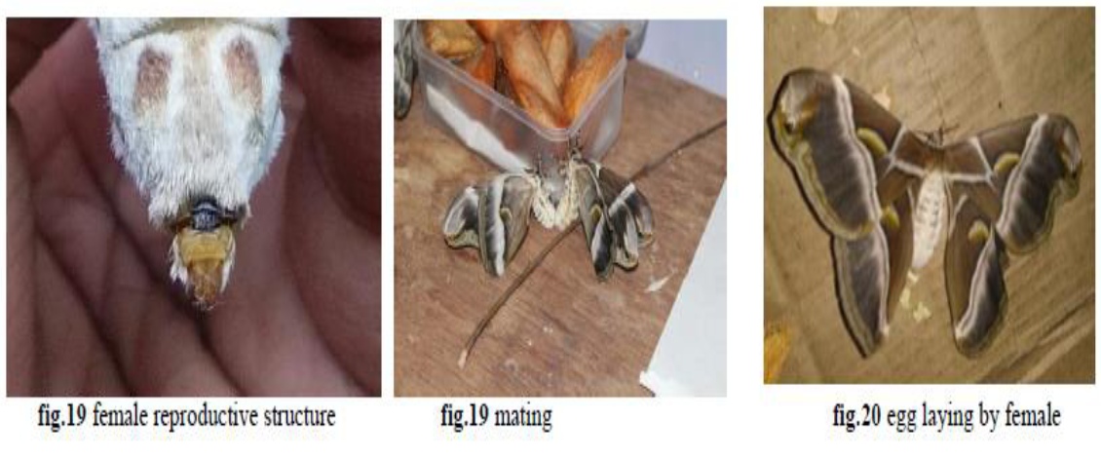

Slide 27


