Slide 1
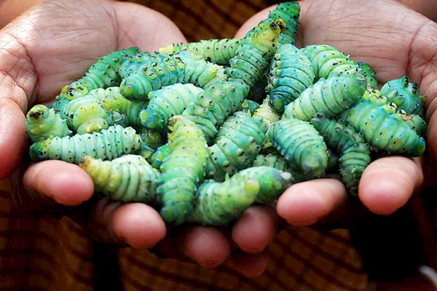
NON-MULBERRY SERICULTURE
SILK GLAND
Presentation by:
JAYDEEP KUMAR NATH
ASSISTANT PROFESSOR
DEPARTMENT OF ZOOLOGY, SALBARI COLLEGE

Slide 2
SILK GLAND
The natural silk synthesized by the silkworm and spun in the form of a silk cocoon is synthesized in the silk gland.
It is a paired organ consisting of modified labial/salivary glands located at the two lateral sides under the alimentary canal.
These glands secrete silk filament which has an inner tough protein fibroin enclosed by a water-soluble gelatinous protein, sericin.
The silk gland becomes the second largest organ after the alimentary canal in order to handle large scale fibroin synthesis. The weight of this organ accounts for about 25% of the weight of larvae in the late fifth instar.

Slide 3
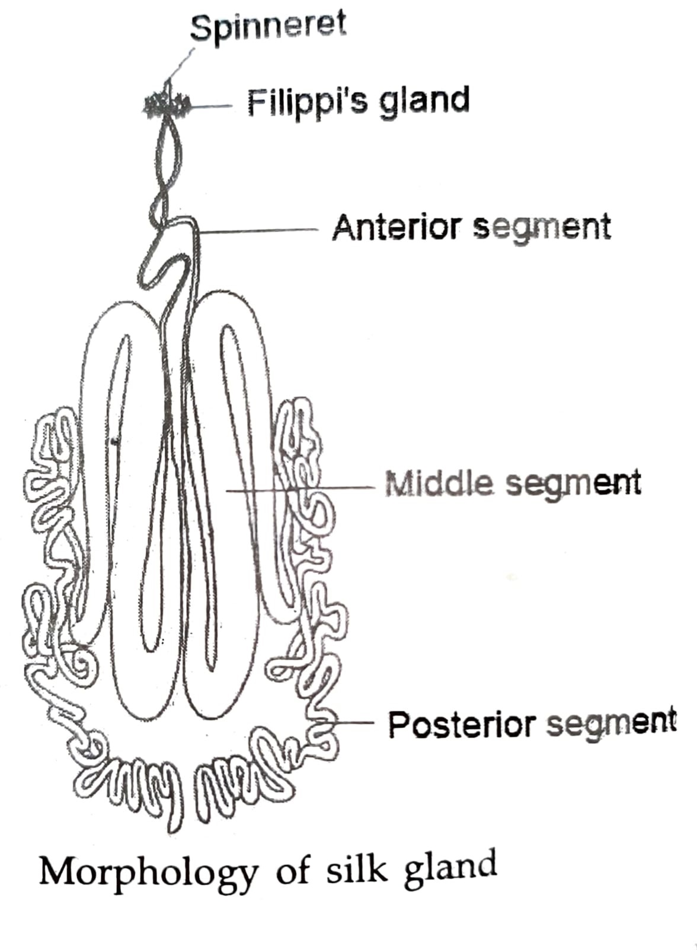
MORPHOLOGY OF SILK GLAND
Silk glands are tubular in shape with different diameters in different regions.
Morphologically the silk gland can be distinguished into three segments: Anterior, Middle and Posterior.
Posterior Segment: The posterior segment is long and thin. The protein fibrinogen which on extrusion is denatured to fibroin is secreted in the posterior segment of silk glands.
.

Slide 4
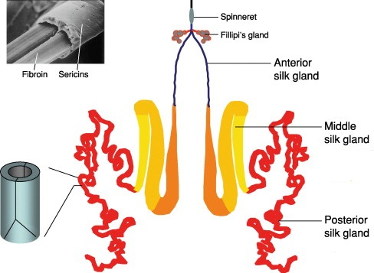
Middle Segment: The middle is short with a diameter measuring 3-4 mm and is itself being composed of three parts, the posterior, middle and anterior limbs. It is the widest region of silk gland and is a W shape in structure. The fibrinogen secreted by the posterior segment moves by peristalsis to the middle region of the gland where it is stored as a viscous aqueous solution until needed for spinning. It forms the core of the silk filament in the form of two very thin fibres, called brins. The sericin secreted by the middle segment of the gland, holds the brins together and covers them.

Slide 5
Anterior Segment: The anterior is extremely thin, leading to the spinneret in the head of the larvae from which the silk is excreted. Anterior part of the silk gland does not secrete anything but acts as passage for silk material.
Histologically the entire gland has 3 layers:
The outer Tunica propia with uniform thickness;
The middle glandular layer with gland cells which increase in size during later instar stages of larval development and
The inner tunica intima of varying thickness.

Slide 6
The protein concentration is 12%-15% in the posterior region of the gland where fibroin chain synthesis occurs, increases to around 20%-30% in the middle region of the gland where the fibroin is stored and sericin is synthesized, and is significantly higher in the anterior region of the gland where spinning is initiated.

Slide 7
SILK PRESS OR SPINNERET
The silkworm spinneret (of about 10 µm in diameter) is an important tissue for silk fibrilogenesis and spinning. Spinneret is a projection of the median part of labium. It helps in bringing out the silk in the form of the fine filament. There are two lobes of the silk gland responsible for silk production. The two lobes of the gland join just before the spinnerets in the anterior region and the fibre is spun into air. The secreted silk comes out as a thread or filament as it passes through silk press which resembles a typical salivary pump. The two filaments coming out of two sides are called brins. The sericin (gum) layer of the two brins then bind together into a single filament or bave.

Slide 8
FILIPPI'S GLAND OR LYONNET'S GLAND
In the head region of the larvae, a pair of glands is situated which open into the anterior part of silk gland near its opening into the spinneret. This gland usually occurs close to the excretory duct of the silk gland, and communicates with it. It has been considered as an accessory gland of the silk gland. The function of Lyonet's gland is still uncertain. Its role in the exchange of small molecules, such as water and ions, in the secretory process of cementing substance for the silk elements, and secretion of some lubricating substance that helps in the extrusion of silk from the silk glands have been suggested.

Slide 9


