Slide 1
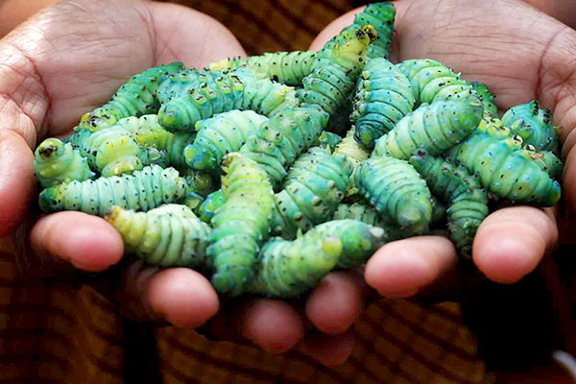
NON-MULBERRY SERICULTURE
Types of Mountages
Presentation by:
JAYDEEP KUMAR NATH
ASSISTANT PROFESSOR
DEPARTMENT OF ZOOLOGY, SALBARI COLLEGE

Slide 2
What is Mounting ?
Transferring of mature silkworm larvae to a suitable frame to spin cocoons is called mounting.
For silkworms, cocoon making is a necessity and indispensible process to get transformed into a healthy pupa and their moth.
Even if the silkworm crop is healthy wrong mounting methods, spinning conditions, mounting density mounting of pre or over matured larvae and bad type of mountages can result in inlerior quality cocoons.

Slide 3
What is Mountage ?
Mountage is a device for providing the medium wherein mature silkworm (5th instar larvae) is allowed to spin cocoon. Mountage plays a significant role in the success of a silkworm crop.
As cocoons are the ultimate commercial product of silkworm exploitation, it is necessary to take proper care of larval spinning for good cocoon harvest in terms of quality and quantity.
Mountages play a vital role in quality cocoon production and determines both the quality and quantity of the cocoons.
Even though the silkworm larvae are healthy, it is estimated that the farmers lose about 12-15% of crop due to defective cocooning which is attributed to inadequate mountages, poor quality of mountages, shortage of time, lack of space, mounting care and non-management of environmental conditions.

Slide 4
Quality of Mountages
A good mountage should possess the following qualities:
It should be convenient for mounting with sufficient and uniform cocooning space.
Material used should absorb moisture caused due to the excretion of urine.
Material should be cheap, durable and easily available locally.
Easy for cleaning and storage after use
Cocoon harvesting should be easy

Slide 5
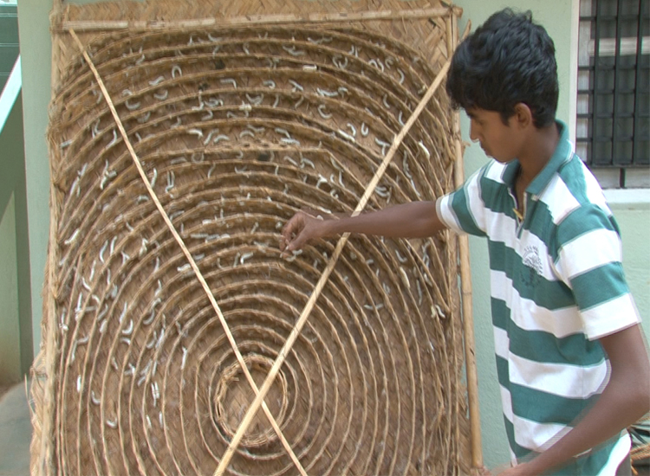
Types of Mountages :
Different types of mountages used by farmers in India are :
Traditional Bamboo Mountage (Chandrika): Chandrika is a round or rectangular-shaped mountage made of bamboo mat supported by split bamboo reapers on all sides. On the mat, a bamboo tape of 4-5 cm width is wound in a spiral manner. The silkworms mounted on straw or bamboo mountages, makes it easy for them to anchor their filament as they spin their cocoons. These are stored vertically. About 1000 worms can be mounted on this mountage.These are easy to handle and repa-irable. Life span of a Chandrika is about 3-4 years normally.

Slide 6
Screen Type Mountage: lt is made of bamboo or wooden or plastic reapers on which, instead of spiral bamboo tape, longitudinal strips with triangular peaks are placed. The screen can be folded and stored. This mountage can be kept clean and well ventilated and hence, cocoons spun on this mountage are of good quality. It is more durable than Chandrika.
Plastic Collapsible Mountage: The Plastic collapsible mountagesare prepared with wavy or corrugated plastic web of 2 cm mesh size placed in a plastic tray. The height of the corrugation is about 6 cm and each mountage is having around 11 corrugations in number.The mounting capacity of each plastic collapsible mountage is about 300 worms. These mountages are, very light in weight, more durable, require less storage space less space is required for storage due to its collapsible nature, easy to handle and disinfect. They help in the production of uniform quality cocoons and also reduces the cost of cocoon production.

Slide 7
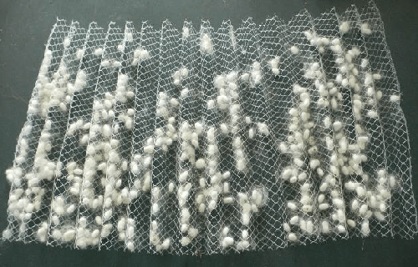
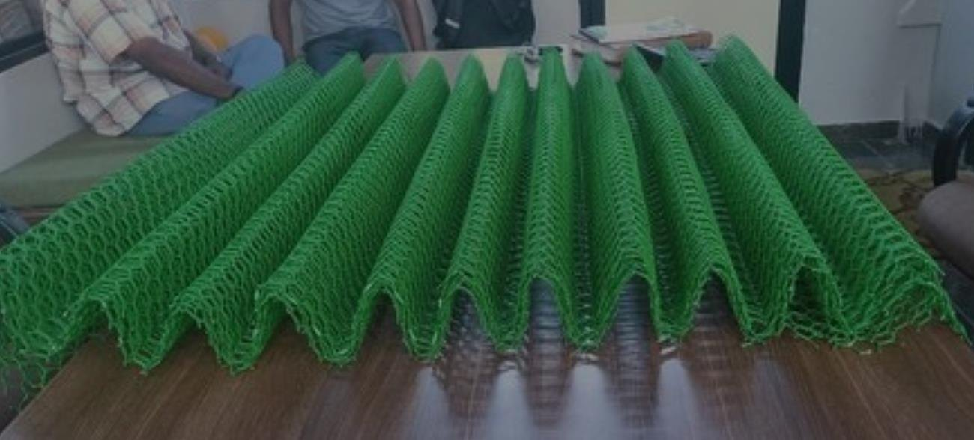
Plastic Collapsible Mountages

Slide 8
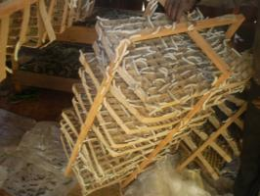
Roatary Mountages : It has pieces of cardboard to form 13 rows, consisting of 12 sections and each and amounting to 156 sections. Ten pieces are put into frame as a set. When this frame is hung up with wire holding at by ends, the frame can be turned around two axes. This frame produces fewer spoiled cocoons and raises the reelability of cocoons. Good cocoon percentage is more than 80. It is the best type and suitable for large scale silkworm rearing because it does not only lead to increased cocoon quality but also saves labour in mounting and harvesting

Slide 9
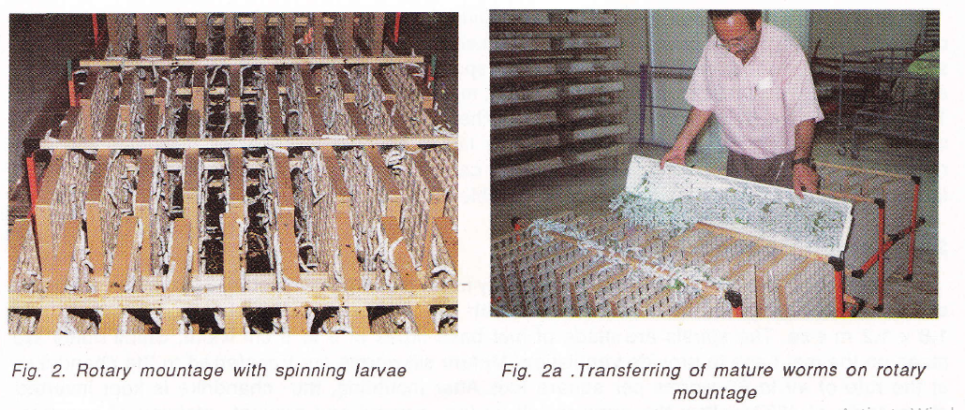

Slide 10
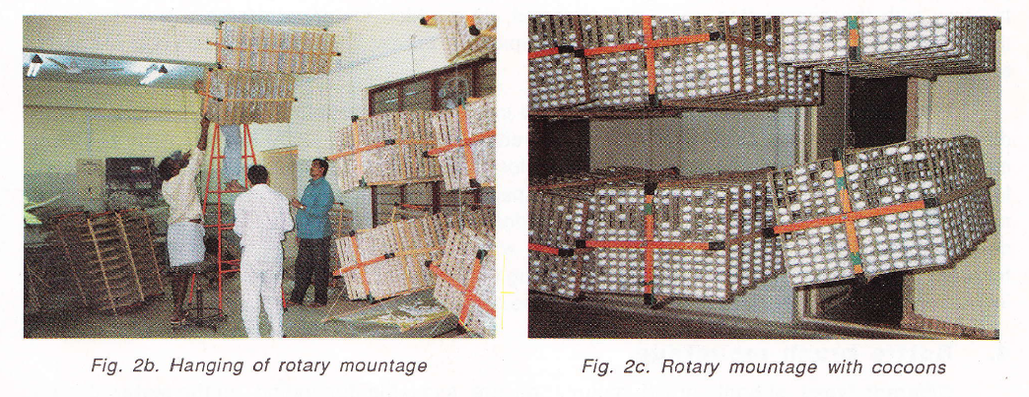

Slide 11
Bottle Brush Mountages : Different types of bottle brush mountages are available depending on the material used. The bottle brush mountages are made of plastic, bamboo or coconut leaf veins. These mountages occupy little space compared to Chandrika. Life span for bamboo bottle brush mountages are 3-4 years and for plastic bottle brush mountages it is 10 years. Urinated cocoons are minimum and reelability improved due to good aeration during the cocooning period. Disinfection, mounting and harvesting operations are also easy in this type of mountages.

Slide 12
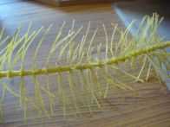
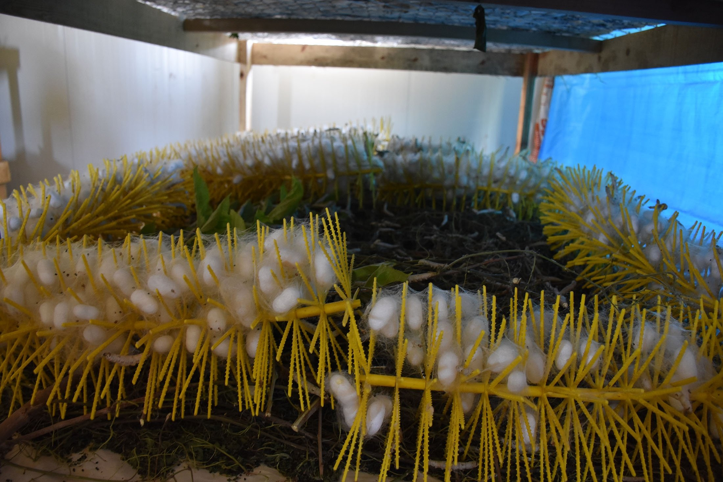
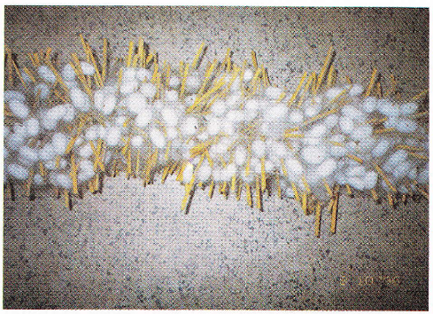
Bottle Brush Mountages

Slide 13
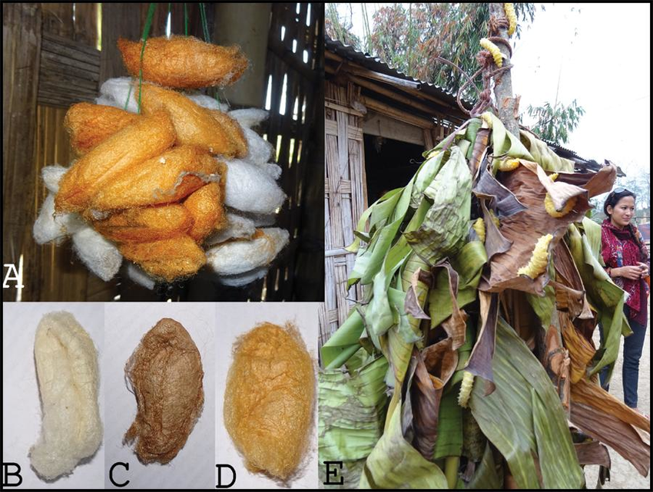
Twigs/Grass/Straw: Mulberry, mango and red gram twigs, paddy straw, dried grass and other similar material are spread on the rearing bed in a three- dimensional direction when all the worms are matured to facilitate the spinning It is cheap, less labour intensive and time saving but shape and size of tire cocoons cannot be maintained.

Slide 14


