Slide 1

Histology of the Liver
Jaydeep Kumar Nath
Asst Professor
Department of Zoology
Salbari College , Baksa

Slide 2
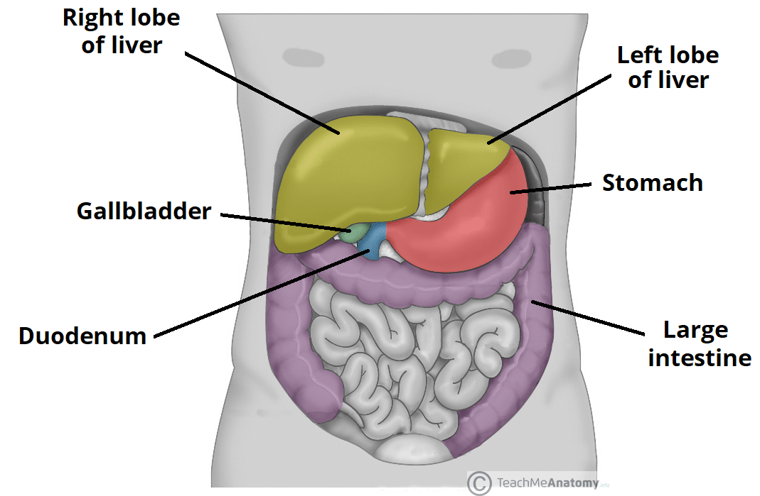
The Liver
It is the largest gland of the body.
The human liver is around 1500 g in weight which comprises around 2.5 % of the body weight.
The liver is located in the upper right-hand portion of the abdominal cavity, beneath the diaphragm, and on top of the stomach, right kidney, and intestines.

Slide 3
Histological Components
The liver consists of the following major histological components:
Parenchyma, which is represented by hepatocytes
Stroma, which is a continuation of the surrounding capsule of Glisson. It consists of connective tissue and contains the vessels. The connective tissue of the stroma is type III collagen (reticulin), which forms a meshwork that provides integrity for the hepatocytes and sinusoids.
Sinusoids, which are capillaries travelling between hepatocytes

Slide 4
Histological Structure
In histological terms, the liver consists of a large number of microscopic functional units that work in unison to ensure the overall, proper activity of the entire organ. Each functional unit consists of :
The Classic Hepatic Lobule
Portal Lobule

Slide 5
The Classic Hepatic Lobule
The classic lobule consists of hexagonal plates of hepatocytes stacked on top of each other. Within each plate, the hepatocytes radiate outwards from a central vein. As they extend towards the periphery, the hepatocytes are arranged into strips, similar to the spokes of a cartwheel. Hepatic sinusoids travel between the strips of hepatocytes, draining into the central vein.
One portal canal is located at each corner of the hexagonal classic lobule, making a total of six for each lobule. These portal canals are composed of the portal triads, which are surrounded by loose stromal connective tissue.

Slide 6
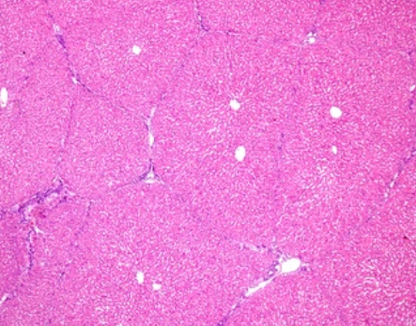

Slide 7
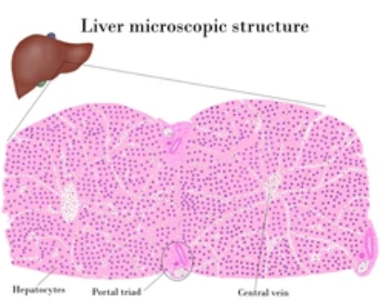

Slide 8
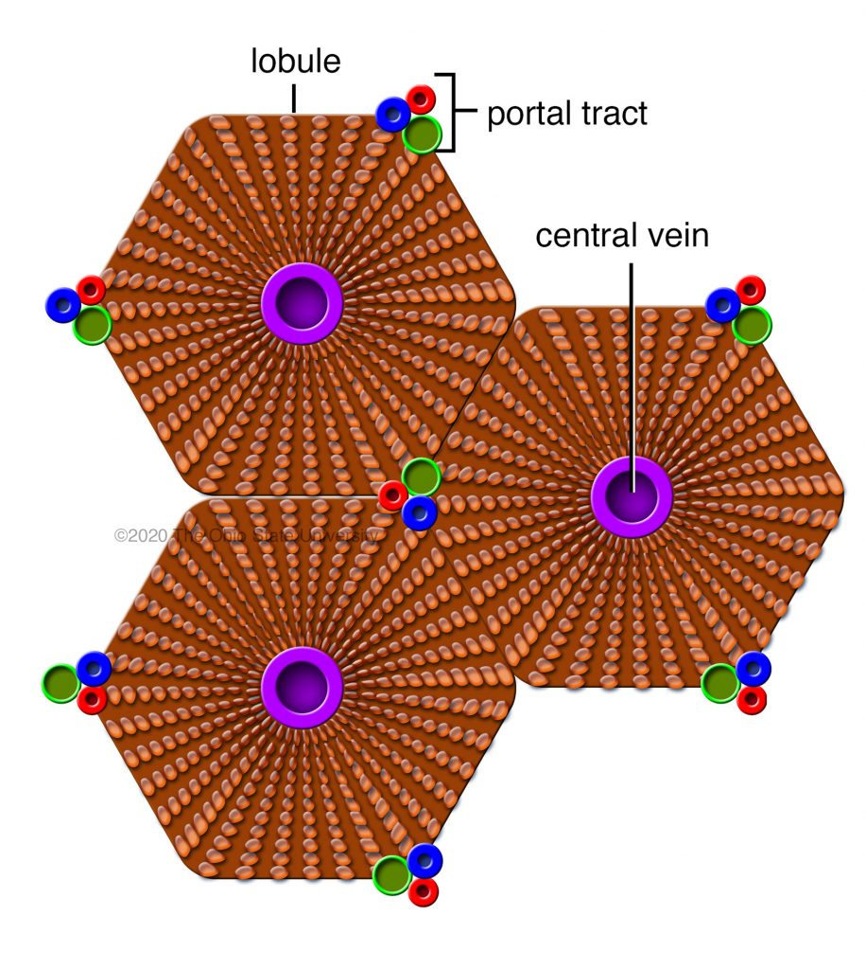
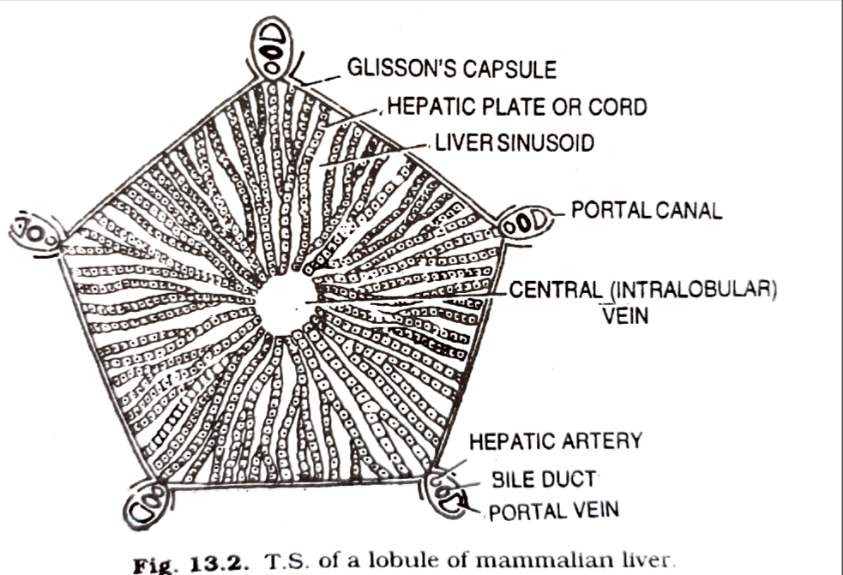

Slide 9
Portal Canal
Connective tissues at the edges of a lobule , constitutes the so called portal canals. Within each canal occur the conspicuous components of the hepatic triad. The functional components of a portal canal are as follows :
Portal Vein : It conveys venous blood , from the stomach , spleen and intestines to the liver. It is thin walled. Venous blood of portal veins is the primary supply (75%) of the hepatic lobules.
Hepatic artery : It is thick walled . These vessels supply about 25 % of the total blood to hepatic lobules.
Bile duct : Its size is intermediate between that of the two blood vessels. It carries bile to the hepatic ducts. Hepatic ducts of the liver are joined by cystic duct from the gall bladder forming a large common bile duct.

Slide 10
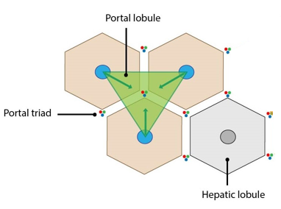
The portal lobule
A different kind of lobule , the portal lobule is recognized in the liver with reference to bile secretion. This unit is formed from parts of three hepatic lobules that adjoin a portal canal. It is the area drained by an interlobular bile duct in a portal canal.
The functional boundary of such a portal lobule extends from one central vein to another. The bile duct , located in the common portal forms axis of such a portal lobule.

Slide 11


