Slide 1
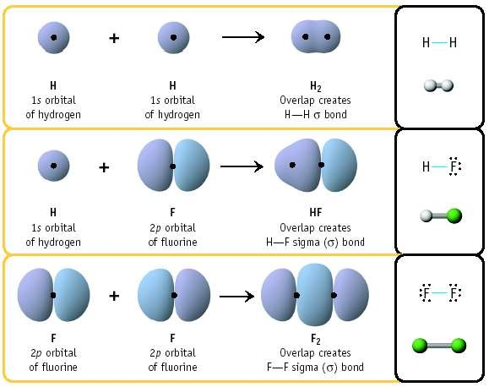

Molecular Orbital Theory
The goal of molecular orbital theory is to describe molecules in a similar way to how we describe atoms, that is, in terms of orbitals, orbital diagrams, and electron configurations.
Molecules can form bonds by sharing electron - Two shared electrons form a single bond Atoms can share one, two or three pairs of electrons - Forming single, double and triple bonds Other types of bonds are formed by charged atoms (ionic) and metal atoms (metallic).
When atoms share electrons to form a bond, their atomic orbitals mix to form molecular bonds. In order for these orbitals to mix they must:
Have similar energy levels.
Overlap well.
Be close together.

Slide 2
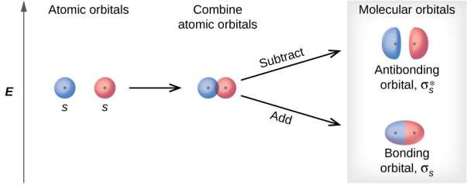
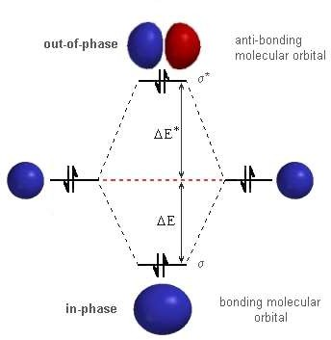
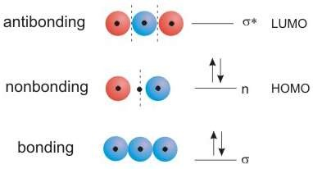
Molecular Orbital Theory
Molecular orbital (MO) theory was developed by F. Hund and R.S. Mullikan in 1932
In valence bond theory, orbitals in a molecule are thought to be localized on atoms, with some overlap of the orbitals between bonded nuclei. In the molecular orbital view, orbitals in a molecule are thought to be spread out (delocalized) over many atoms.
Valence bond theory is often referred to as a localized bonding theory while molecular orbital theory is referred to as a delocalized bonding theory.
The molecular orbital theory is used to predict the shapes and energies of orbitals that contain no electrons.
Principle of MOT
“ Any number of atomic orbitals overlaps to form molecular orbitals, an equal number of molecular orbitals are formed. When two s orbitals overlap, they form two new orbitals: one at lower energy than the original s orbitals and one at higher energy than the original s orbitals”.

Slide 3
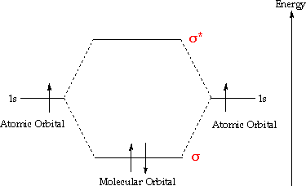
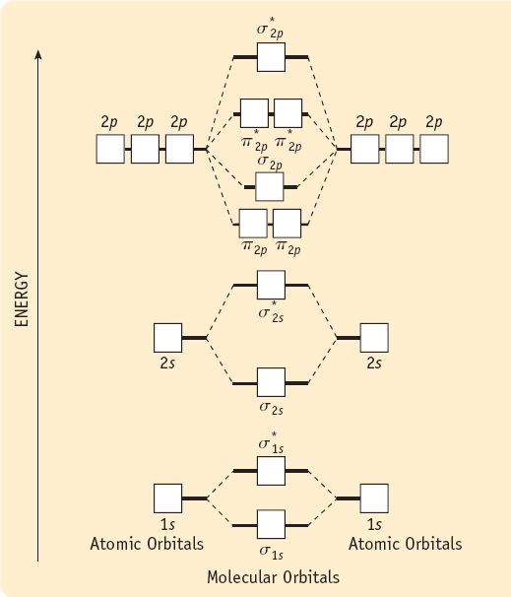
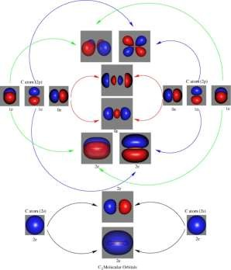
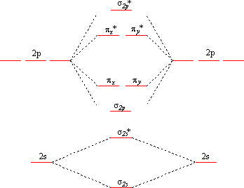
Molecular Orbital Theory
Each line in the diagram represents an orbital.
The electrons fill the molecular orbitals of molecules like
electrons fill atomic orbitals in atoms
Electrons go into the lowest energy orbital available to form lowest potential energy for the molecule.
The maximum number of electrons in each molecular orbital is two. (Pauli exclusion principle)
One electron goes into orbitals of equal energy, with parallel spin,
before they begin to pair up. (Hund's Rule.)

Slide 4
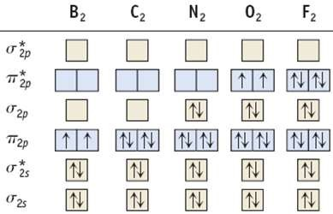
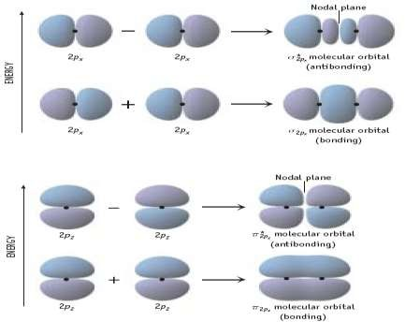
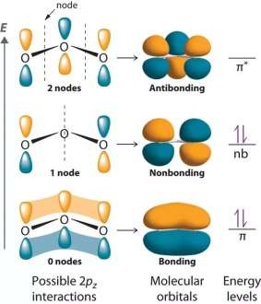
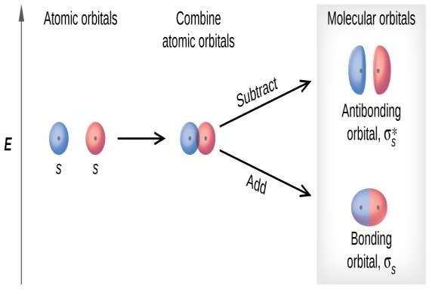
Molecular Orbital Theory
Atomic orbitals mix together and make:
  Bonding Orbitals
Electrons in these orbitals help hold atoms near each other
  Antibonding Orbitals
Electrons in these orbitals push
atoms apart from each other
  Nonbonding Orbitals
Electrons in these orbitals have no effect on bonding
Molecular Orbitals can:
  be Sigma or Pi
  be spread over multiple atoms
  Paramagnetic: a compound
with any unpaired electrons
  Diamagnetic: no unpaired electrons.

Slide 5
Molecular Orbital Theory
Comparison of bonding theories:
Valence Bond Theory | Molecular Orbital Theory
considers bonds as localized between one pair of atoms | considers electrons delocalized throughout the entire molecule
creates bonds from overlap of atomic orbitals (s, p, d…) and hybrid orbitals (sp, sp², sp³…) | combines atomic orbitals to form molecular orbitals (σ, σ*, π, π*)
forms σ or π bonds | creates bonding and antibonding interactions based on which orbitals are filled
predicts molecular shape based on the number of regions of electron density | predicts the arrangement of electrons in molecules
needs multiple structures to describe resonance | No needs multiple structures to describe resonance

Slide 6
Molecular Orbital Theory
Linear combination of atomic orbitals to give molecular orbitals LCAO-MO approach
The technique used to construct molecular wave functions is known as the linear combination of atomic orbitals (denoted as LCAO-MO). The linear combination of atomic orbitals can be written mathematically as –
𝜑 = ∑ 𝑎_{𝑖} ∅_{𝑖} (1)
Where, 𝜑 is the molecular wave function, ∅ is atomic wave function, and a is a weighting coefficient that gives the relative
weight in the “mix” of the atomic wave functions.
For diatomic molecule, i = 2, then –
𝜑 = 𝑎₁ ∅₁ + 𝑎₂ ∅₂
The average value for a dynamical variable a whose operator is α, is calculated by using following relationship (𝑟, 𝜃, 𝜑)
are polar co-ordinates and energy is -
∫ 𝜑∗ 𝛼 𝜑 𝑑𝑟
∫ 𝜑∗ 𝐻^ 𝜑 𝑑𝑟
𝑎 =
𝐸 =
∫ 𝜑∗𝜑 𝑑𝑟
∫ 𝜑∗𝜑 𝑑𝑟
Where, 𝐻^ is the Hamiltonian operator, the operator for total energy. Substituted equation (1) for 𝜑 in the equation -
_{𝐻}^
∫ 𝑎₁ ∅₁∗ + 𝑎₂ ∅₂∗ 𝑎₁ ∅₁ + 𝑎₂ ∅₂ 𝑑𝑟
𝐸 =
∗ ∗
∫ 𝑎 ∅ +
𝑎 ∅ 𝑎 ∅ + 𝑎 ∅ 𝑑𝑟
Simply above equation –
1 1 2 2 1 1 2 2
𝑎₁² ∫ ∅₁∗ 𝐻^ ∅₁ 𝑑𝑟 + 2 𝑎₁𝑎₂ ∫ ∅₁∗ 𝐻^ ∅₂ 𝑑𝑟 + 𝑎₂² ∫ ∅₂∗ 𝐻^ ∅₂
𝑑𝑟
𝐸 =
∗
∗
∗
𝑎₁² ∫ ∅₁ ∅₁ 𝑑𝑟 + 2 𝑎₁𝑎₂ ∫ ∅₁
∅ 𝑑𝑟 + 𝑎
² ∫ ∅
∅ 𝑑𝑟
2
2
2
2

Slide 7
Molecular Orbital Theory
it is assumed that –
∫ ∅₁∗ 𝐻^ ∅₂𝑑𝑟 = ∫ ∅₂∗ 𝐻^ ∅₁𝑑𝑟
∫ ∅₁∗ ∅₂𝑑𝑟 = ∫ ∅₂∗ ∅₁𝑑𝑟
These assumptions are valid for a diatomic molecule composed of identical atoms (homonuclear diatomic) because ∅₁ and ∅₂
are identical and real.
According to the definition of H₁₁ and H₁₂, we have –
^{𝐻}11
^{𝐻}12
=
=
∫ ∅₁∗ 𝐻^ ∅₁𝑑𝑟
∫ ∅₁∗ 𝐻^ ∅₂𝑑𝑟
𝐻^ is the operator for total energy, H₁₁ represents the binding energy of an electron in atom 1 to its nucleus. If the subscripts on the wave functions are both 2, the binding energy of electron in atom 2 to its nucleus. Such integrals represent the energy of an electrostatic interaction so they are known as Coulomb integrals.
H₁₂ represents the energy of the interaction of the electron in atom 1 with the nucleus of atom 2 and vice versa. Therefore, they are known as exchange integrals. Interactions of this type must be related to the distance separating the nuclei.

Slide 8
Molecular Orbital Theory
The equation (6) can be simplify as -
𝐸 =
𝑎₁² 𝐻₁₁ + 2 𝑎₁𝑎₂ 𝐻₁₂ + 𝑎₂² 𝐻₂₂
𝑎₁² + 2 𝑎₁𝑎₂ 𝑆₁₂ + 𝑎₂²
To find a minimum in the energy expression, we take the partial derivatives with respect to a₁ and a₂ and set them equal to 0:
𝛛𝐸 𝛛𝐸
= 0 and = 0
𝛛𝑎₁
𝛛𝑎₂
𝑎₂ 𝑎₁
When the differentiations are carried out with respect to a₁ and a₂ in turn while keeping the other constant, we obtain two equations as –
a₁(H₁₁ – E) + a₂(H₁₂ – S₁₂ E) = 0 a₂(H₂₂ – E) + a₁(H₂₁ – S₂₁ E) = 0
These equations are known as the secular equations, in which the weighting coefficients a₁ and a₂ are the unknowns.
𝐻₁₁ − 𝐸
𝐻₂₁ − 𝑆₂₁𝐸
𝐻₁₂ − 𝑆₁₂𝐸
𝐻₁₁ − 𝐸
= 0
For the homonuclear diatomic molecule, H₁₂ = H₂₁, H₁₁ = H₂₂ and S₁₂ = S₂₁ = S, then (H₁₁ – E)² - (H₁₂ – S E)² = 0 (H₁₁ – E) = ± (H₁₂ – S E)
From which we find two values for E -
𝐻₁₁ + 𝐻₁₁−
𝐸_{𝑏} =
^{𝐻}12
and 𝐸 =
^{𝐻}12
1+𝑆
𝑎
1−𝑆

Slide 9
Molecular Orbital Theory
In addition to the integrals that represent energies, another integral called as overlap integrals, and they represent
effectiveness with which the orbitals overlap in a region of space.
^{𝑆}11
^{𝑆}12
= ∫ ∅₁∗ ∅₁𝑑𝑟
= ∫ ∅₁∗ ∅₂𝑑𝑟
If the subscripts are identical, orbitals on the same atom are indicated, and if the atomic wave functions are normalized, the value of such an integral is 1.
=
∫ ∅₁∗ ∅₁𝑑𝑟
∫ ∅₁∗ ∅₂𝑑𝑟
= 𝑆₂₂ and
= 𝑆₂₁
^{𝑆}11
^{𝑆}12
= | ∫ ∅₂∗ ∅₂𝑑𝑟 | = | 1
= | ∫ ∅₂∗ ∅₁𝑑𝑟
=
These integrals are related to the degree of overlap of an orbital on atom 1 with an orbital on atom 2. If the two atoms are separated by a large distance, the overlap integral approaches to 0. However, if the atoms are closer together, there is some overlap of the orbitals and S > 0.
Overlap integral is lies in between 0 to 1 and is function of the internuclear distance.

Slide 10
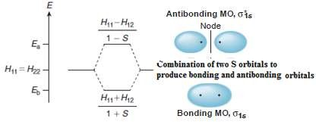
Molecular Orbital Theory
The energy state labeled E_{b} is known as the bonding or symmetric state, whereas that designated as E_{a} is called the antibonding
or asymmetric state.
a₁ = a₂ (for the symmetric state) and a₁ = -a₂ (for the antisymmetric state) Therefore,
𝜑 = 𝑎 ∅ + 𝑎 ∅ =
1
(∅ + ∅ )
𝑏 1 1 2 2
2+2𝑆
1
1 2
𝜑 =
𝑎 ∅ −
𝑎 ∅ =
(∅₁ − ∅₂)
𝑎
1 1
2 2
2−2𝑆

Slide 11
Molecular Orbital Theory
Difference between Bonding and Antibonding molecular orbitals
Bonding MO | Antibonding MO
It is formed by addition overlap of atomic orbitals. | It is formed by subtraction overlap of atomic orbitals.
The wave function of a bonding MO is given by ^{ψ}(MO) ^{= ψ}A ^{+ ψ}B | The wave function of an antibonding MO is given by ψ*_{(MO)} = ψ_{A} – ψ_{B}
Its formation takes place when the lobes of atomic orbitals have same signs. | Its formation takes place when the lobes of atomic orbitals have different signs.
The energy of bonding MO is lower than that of atomic orbitals from which it is formed. | The energy of antibonding MO is higher than that of atomic orbitals from which it is formed.
The electron density is high in the region between the nuclei of bonded atoms. | The electron density is low in the region between the nuclei of bonded atoms.
Every electron in bonding MO contributes towards the attractive force. | Every electron in antibonding contributes towards repulsive force.

Slide 12
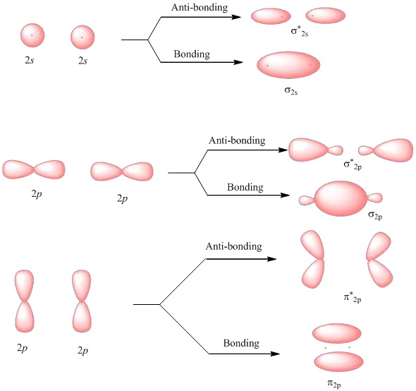
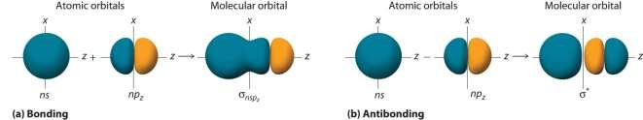
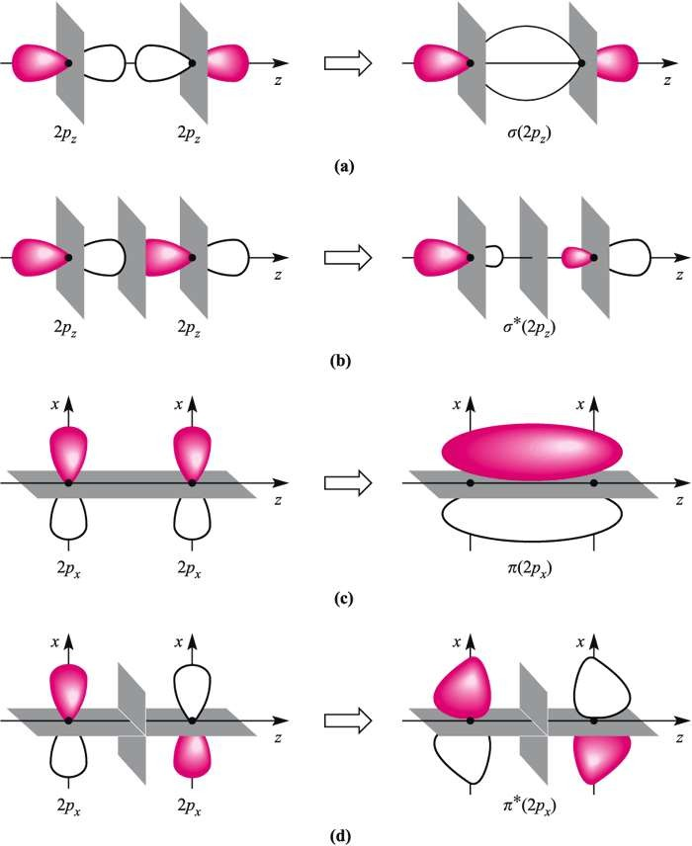
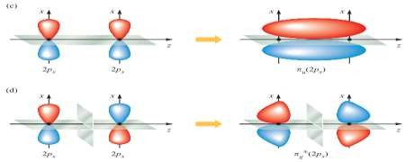
Molecular Orbital Theory – Orbital overlapping
S – S orbital MO
---------------------
S – P_{z} orbital MO
P_{x} – P_{x} orbital MO
P_{z} – P_{z} orbital MO
P_{y} – P_{y} orbital MO

Slide 13
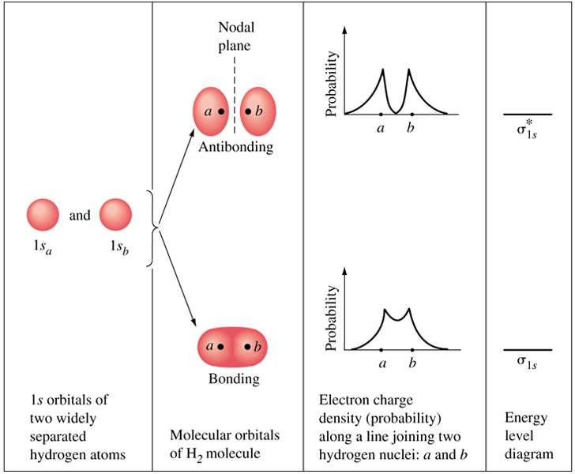

Molecular Orbital Theory –
Homonuclear diatomic molecules
H2
E = 11.4 eV
---------------------
LCAO of n A.O ⇒ n M.O.
Bond length = 109 nm
Location of Bonding orbital
4.5 eV

Slide 14
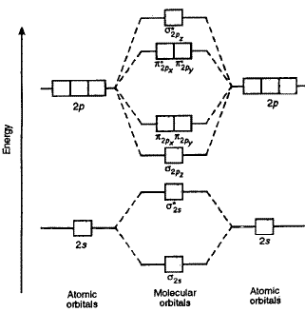
Molecular Orbital Theory – Homonuclear diatomic molecules
When atoms share electrons to form a bond, their atomic orbitals mix to form molecular bonds. In order for these orbitals to mix they must:
Have similar energy levels.
Overlap well.
Be close together – positive/in-phase overlap (bonding), negative/out of phase overlap (anti-bonding)
Advantageous:
1. Electron
bonding electrons
density in
Bonding and anti-
Molecular stabilizes
orbitals; bonding
Molecule while anti-
bonding electron destabilizes Bonding.
2. Bond order: As bond order increases, stabilization of the molecule increases with increase in bond order and decrease in bond length.
= ½[(number of bonding electrons) – (number of antibonding electrons)]
All homonuclear diatomic molecules (2nd row contain 1s, 2s & 2p orbitals. these molecules are divided in three groups:
3. Magnetic properties: Diamagnetic (all
electrons are paired; Paramagnetic (atleast one electron is unpaired).
Use 1s & 2s orbitals – H₂, He₂, Li₂ and Be₂.
Use 1s, 2s, and 2p orbitals – O₂, F₂ and He₂.
Use 1s, 2s & 2p after mixing – B₂, C₂ & N₂.

Slide 15
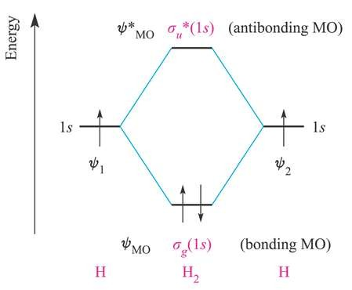

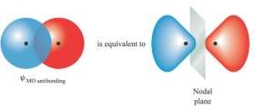
Molecular Orbital Theory – Hydrogen molecule
Each of the H atoms has 1s¹ atomic orbital with associated wave functions, Ψ₁ and Ψ₂ and the signs of the wave function associated with the 1s orbital may be either + or -.
The possible combinations of the two 1s orbitals are given by equations:
𝜑_{𝑏} = 𝑎₁ ∅₁ + 𝑎₂ ∅₂ = 𝑁(∅₁ + ∅₂)
𝜑_{𝑎} = 𝑎₁ ∅₁ − 𝑎₂ ∅₂ = 𝑁(∅₁ − ∅₂)
The interaction between the H 1s AOs on forming H₂ may be represented by the MO diagram shown below.
constructive interference
in-phase (bonding) interaction
destructive interference
out-of-phase (antibonding) interaction
The ground state electronic configuration of H₂ may be written as using the
notation; σ_{g} (1s²) σ*_{u} (1s⁰).
Bond order = ½[(number of bonding electrons) – ( number of antibonding electrons)]
= ½[2 – 0] = 1
i.e. Hydrogen molecule contain one σ-bond.
H₂ molecule is diamagnetic - All electrons are paired.

Slide 16
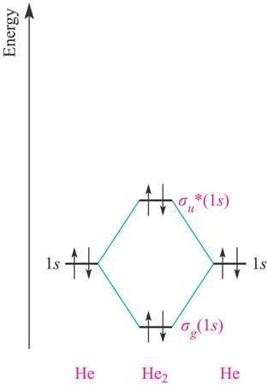
Molecular Orbital Theory – Helium molecule
Each of the He atoms has 1s² atomic orbital with associated wave functions, Ψ₁ and Ψ₂.
Molecular orbital electronic configuration - σ_{g} (1s²) σ_{u}* (1s²).
The bonding effect of the σ_{g} (1s²) is cancelled by the anti-bonding effect of σ_{u}* (1s²).
The He₂ molecule is not a stable species.
Bond order = 0
He₂ molecule is diamagnetic - All electrons are paired.

Slide 17
Molecular Orbital Theory
Consider H ⁺, H , He ⁺, He : first row diatomic molecules and ions
2 2 2 2
 | H₂ | _{H2}+ | He₂⁺ | He₂
σ_{g} (1s²) E * 2 σ_{u} (1s ) | ↑↓ | ↑ | ↑ ↑↓ | ↑↓ ↑↓
Magnetism | Dia- | Para- | Para- | -
Bond order | 1 | ½ | ½ | 0
Bond energy (kJ/mol) | 436 | 225 | 251 | -
Bond length (pm) | 74 | 106 | 108 | -

Slide 18
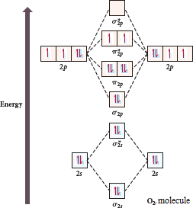
Molecular Orbital Theory
O₂ molecule
The electronic configuration of oxygen is 1s²2s²2p⁴
The ground electronic configuration of O₂ molecule, therefore, is - σ(1s)² σ*(1s)² σ(2s)² σ*(2s)² σ(2p_{z})² π(2p_{x})² π(2p_{y})² π*(2p_{x})¹ π*(2p_{y})¹.
O₂ molecule should be paramagnetic.
From the electronic configuration of O₂ molecule, it is clear that ten electrons are present in bonding molecular orbitals and six electrons are present in antibonding molecular orbitals.
Its bond order, therefore, is = ½ (10 – 6) = 2.

Slide 19
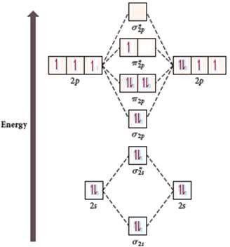
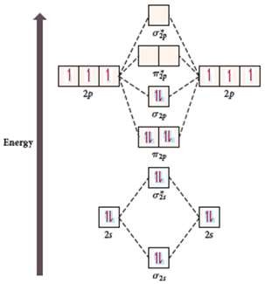
Molecular Orbital Theory
𝑶⁺ molecule
𝑶^{𝟐+} molecule
𝟐
𝟐
electronic configuration of O-ion is 1s²2s²2p³.
σ(2s)²σ*(2s)²σ(2p_{z})²π(2p_{x})²π(2p_{y})²π*(2p_{x})¹π*(2p_{y})⁰.
Bond order = ½ (8 – 3) = 2.5. Magnetic property: Paramagnetic
electronic configuration of O-ion is 1s²2s²2p².
σ(2s)²σ*(2s)²π(2p_{x})²π(2p_{y})²σ(2p_{z})²π*(2p_{x})⁰π*(2p_{y})⁰.
Bond order = ½ (8 – 2) = 3 Magnetic property: Diamagnetic

Slide 20
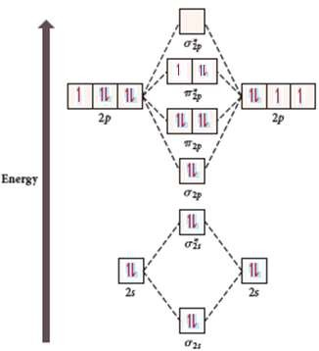
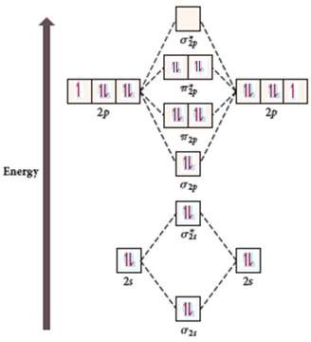
Molecular Orbital Theory
𝑶⁻ molecule
𝑶^{𝟐−} molecule
𝟐
electronic configuration of O-ion is 1s²2s²2p⁵
σ(2s)² σ*(2s)² σ(2p_{z})² π(2p_{x})² π(2p_{y})² π*(2p_{x})² π*(2p_{y})¹
Bond order = ½ (8 – 5) = 1.5 Magnetic property: Paramagnetic
𝟐
electronic configuration of O-ion is 1s²2s²2p⁶
σ(2s)² σ*(2s)² σ(2p_{z})² π(2p_{x})² π(2p_{y})² π*(2p_{x})² π*(2p_{y})² Bond order = ½ (8 – 6) = 1
Magnetic property: Diamagnetic

Slide 21
Molecular Orbital Theory
F₂ molecule
Electronic configuration of fluorine is 1s²2s²2p⁵
The ground electronic configuration of F₂ molecule, therefore, is -
σ(1s)² σ*(1s)² σ(2s)² σ*(2s)² σ(2p_{z})² π(2p_{x})² π(2p_{y})² π*(2p_{x})² π*(2p_{y})² From the electronic configuration of F₂ molecule, it is clear that ten
electrons are present in bonding molecular orbitals and eight
electrons are present in antibonding molecular orbitals. Its bond order, therefore, is = ½ (10 – 8) = 1
F atoms are held by single bond and it diamagnetic in nature.

Slide 22
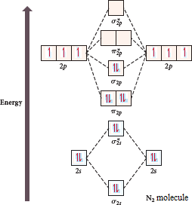
Molecular Orbital Theory
N₂ molecule
The electronic configuration of nitrogen is 1s²2s²2p³.
There are fourteen electrons in N₂. The ground electronic
configuration of N₂ molecule, therefore, is –
σ(1s)² σ*(1s)² σ(2s)² σ*(2s)² π(2p_{x})² π(2p_{y})² σ(2p_{z})² Bond order of N₂ = ½ (10 – 4) = 3.
It is important to note that triple bond in N₂ consists of one sigma ant two pi bonds because of the presence of two electrons in sigma-orbital and four electrons in two pi molecular orbitals.
N₂ is diamagnetic in nature.

