Slide 1
SEMINAR PRESENTED
ON
RECTIFIERS
By Dr. Priyanka Das

Slide 2
Overview
Introduction
Types of Rectifiers
Half wave rectifier
Output dc voltage calculation
Full wave rectifier
Calculation formula
Bridge rectifier
Positive & negative half cycle
Output wave forms

Slide 3
Introduction
“A rectifier is an electrical device that converts alternating current (AC), which periodically reverses direction, to direct current (DC), which is in only one direction, a process known as rectification.”

Slide 4
Types of Rectifiers
Half wave Rectifier
Full wave Rectifier
Bridge Rectifier

Slide 5
Half wave rectifier
In half wave rectification, either the positive or negative half of the AC wave is passed, while the other half is blocked.
Since only one half of the input waveform reaches the output, it is very inefficient if used for power transfer.

Slide 6
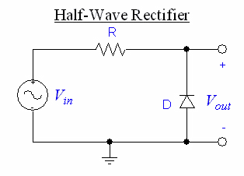

Slide 7
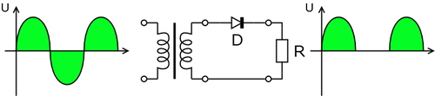
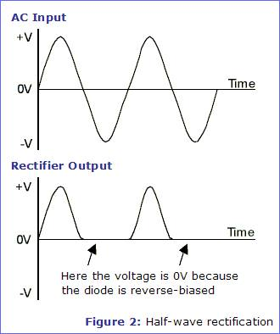
Half wave rectifier working animation

Slide 8


Output dc voltage calculation
The output DC voltage of a half wave rectifier can be calculated with the following two ideal equations

Slide 9
Full wave rectifier
A full-wave rectifier converts the whole of the input waveform to one of constant polarity (positive or negative) at its output.
Full-wave rectification converts both polarities of the input waveform to DC (direct current), and is more efficient.

Slide 10
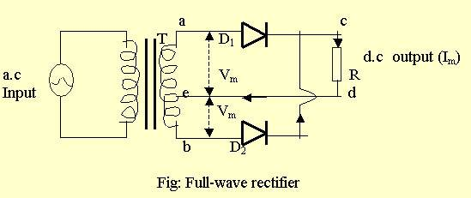
Full wave rectifier

Slide 11
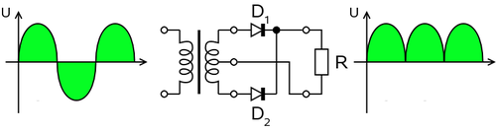
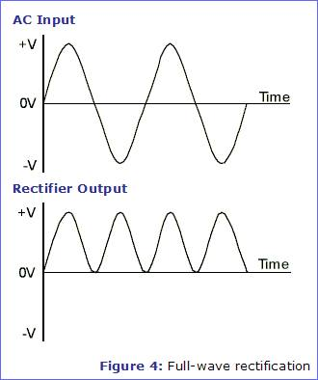
Full wave rectifier working animation

Slide 12
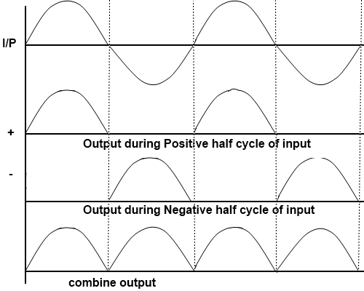
Output wave forms

Slide 13
Full wave rectification
In a circuit with a non - center tapped transformer, four diodes are required instead of the one needed for half-wave rectification.
For single-phase AC, if the transformer is center-tapped, then two diodes back-to-back (i.e. anodes-to-anode or cathode-to-cathode) can form a full-wave rectifier.

Slide 14


Calculation formula
The average and root-mean-square output voltages of an ideal single phase full wave rectifier can be calculated as:

Slide 15
Bridge rectifier
A bridge rectifier makes use of four diodes in a bridge arrangement to achieve full-wave rectification.

Slide 16
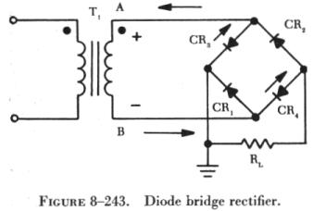
Bridge rectifier circuit

Slide 17
Thank You …

