Slide 1
The Schrödinger Wave Equation and Physical Significance
Faculty: Dr. Karabi Roy
UG 1st SEM (MAJOR)
Dept. of Chemistry

Slide 2
Background
Classical mechanics physical theory describing the motion of macroscopic objects
projectiles to parts of machinery, and astronomical objects, such as spacecraft, planets and stars
Fails in describing motion of microscopic particles (electrons, atoms, protons and molecules)
So, a new, correct equation of motion is needed and it has to recognize
1. Quantized nature of energy 2. Wave particle duality
at subatomic levels, energy is best thought of as occurring in discreet "packets" called photons
possession by physical entities (such as light and electrons) of both wave-like and particle-like characteristic

Slide 3
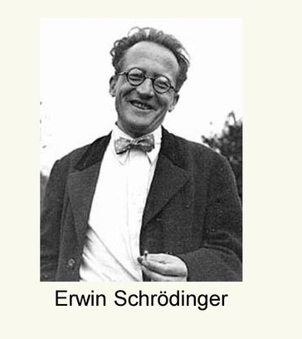
The Schrödinger wave equation
The correct equation of motion that works for microscopic particles was formulated by Erwin Schrödinger in 1926.
Hamiltonian operator
ĤΨ=EΨ
Wave function
Energy
..
The Schrodinger wave equation

Slide 4
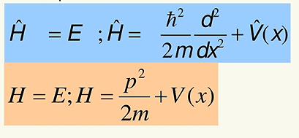
The Schrödinger wave equation
How did Schrödinger came up with the formulation?
In quantum mechanics, energy should be conserved, just as in classical mechanics.
Schrödinger used the Hamilton’s equation as the basis of quantum mechanics.
Quantum
Classical
Potential energy
Kinetic energy

Slide 5
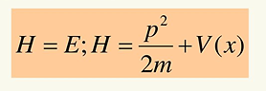
The Schrödinger wave equation
In classical mechanics, H is a function of p (momentum), m (mass) and x (position); p and x are functions of time.
Once we know the mass (m), position (x) and velocity (p=mv) of a particle, we can know the exact trajectory (positions as a function of time) of the particle from the classical mechanics
Potential energy
Kinetic energy
However, the concept of trajectory is strictly for particles only.

Slide 6
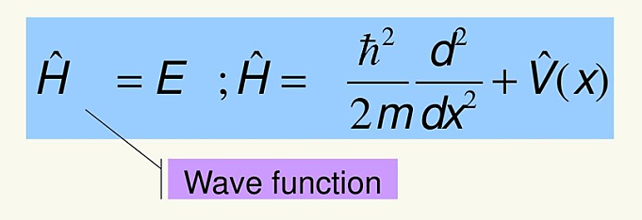
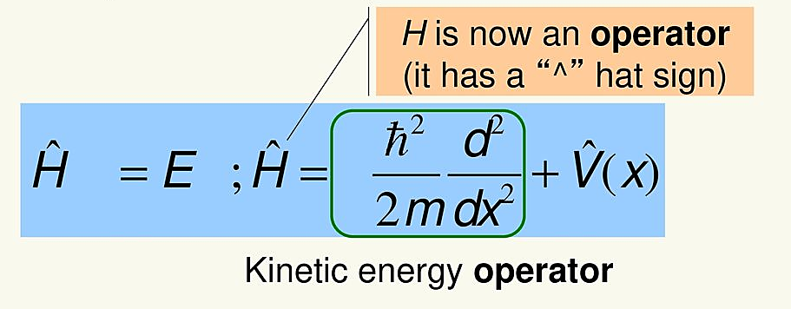
The Schrödinger wave equation
Schrödinger modified the equation to account for the wave-particle duality
  Introduction of a wave function
Ψ
Ψ
The equation must also give energies that are quantized
    The operator form of equation

Slide 7
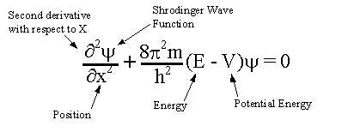
The Schrödinger wave equation
Definition:
Schrödinger wave equation is a mathematical expression describing the energy and position of the electron in space and time, taking into account the matter wave nature of the electron inside an atom.

Slide 8
The Schrödinger wave equation
Moving electrons behave both as particles and as wave.
So, if the electrons behave as a wave there must be a wave equation to describe their behaviour
Therefore,
    Schrödinger gave a wave equation to describe the wave nature of electrons in atoms and molecules
The Schrödinger wave equation for an electron wave propagating in three dimensions in space is :
∂²Ψ⁄ ∂x ²+ ∂²Ψ⁄ ∂y ²+ ∂²Ψ⁄ ∂z²+8π²m/h²(E-V)Ψ=0
where,
x, y, z = three space co-ordinates, m = mass of electron, h = Plank`s constant, E = total energy of electron,V = electrostatic potential energy and Ψ = wave function.

Slide 9
The Schrödinger wave equation
∂²Ψ⁄ ∂x ²+ ∂²Ψ⁄ ∂y ²+ ∂²Ψ⁄ ∂z²+8π²m/h²(E-V)Ψ=0
1
Eqn. 1 is customarily written in the following form:
[-{ћ ²/2m} (∂²⁄ ∂x²+ ∂²⁄ ∂y²+ ∂²⁄ ∂z²)+ V] Ψ=E Ψ
2
or
[-(ћ ²/2m)∇²+ V] Ψ=E Ψ
3
where, ћ is h/2π and ∇² is the Laplacian operator defined as ∇²= ∂²⁄ ∂x²+ ∂²⁄ ∂y²+ ∂²⁄ ∂z²
The complete mathematical operator of Ψ is the Hamiltonian operator Ĥ
Thus, Ĥ= -(ћ ²/2m)∇² + V
Eqn. 3 becomes,
Ĥ Ψ=E Ψ
4

Slide 10
The Schrödinger wave equation
What is the significance of the wave equation ?
The Schrödinger wave equation is a second order differential equation. It has countless solutions, many of them having no significance.
Out of these, only those solutions are significant which give certain definite and acceptable values of the total energy E.
The acceptable values of the total energy E of wave particle given by a solution is called eigen value and the corresponding function Ψ which gives eigen value of the energy, is called eigen function.
The Hamiltonian operator Ĥ consists of two parts :
    the kinetic energy part (-ћ ²/2m)∇² and
    the electrostatic potential energy part (V)
The function Ψ signifies the amplitude of the electron wave and is called the wave function

Slide 11
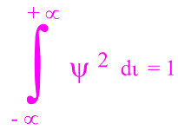
The Schrödinger wave equation
An acceptable solution of the Schrodinger wave equation i.e. an eigen function, must satisfy the following conditions:
The function should be finite
It should be single-valued (i.e. it should not have more than one value at a point in space)
It should be continuous (i.e. the function if plotted in space should not show a break)
∂ ²Ψ⁄ ∂x², ∂²Ψ/ ∂y², etc. should also be continuous
The function should be normalised, i.e. means the probability that the particle is found somewhere in space is equal to 1
This is the significance of Schrödinger wave equation in quantum mechanics.

Slide 12
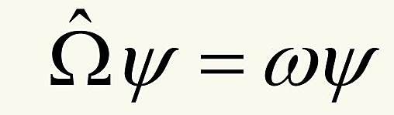
The Schrödinger wave equation
Eigenvalue and Eigenfunction:
In general, operator Ω (omega) and function Ψ (psi) satisfy the equation of the form:
where, ω is some constant factor, we call ω an eigenvalue of the operator Ω and Ψ an eigenfunction of Ω.
The equation of this form is called eigenvalue equation.

Slide 13
The Schrödinger wave equation
What is the significance of wave function?
The wave function Ψ in Schrödinger wave equation, has no physical significance except than it represents the amplitude of the electron wave.
However, the square of the wave function ,that is, |Ψ|² gives the probability of an electron of a given energy E, from place to place in a given region around the nucleus .
It is thus possible to identify regions of space around the nucleus where there is high probability of locating an electron associated with a specific energy. This space is called an atomic orbital.
An atomic orbital, thus represents a definite region in three dimensional space around the nucleus where there is high probability of finding an electron of a specific energy E.
A larger value of |Ψ|² means stronger probability and a smaller value of |Ψ|² means lesser probability of electron's presence.

Slide 14
Important Questions for Schrödinger Equation
Q1. What is a wave function?
Answer: Wave function is used to describe ‘matter waves’. Matter waves are very small particles in motion having a wave nature – dual nature of particle and wave. Any variable property that makes up the matter waves is a wave function of the matter-wave. Wave function is denoted by a symbol ‘Ψ’.
Amplitude, a property of a wave, is measured by following the movement of the particle with its Cartesian coordinates with respect of time. The amplitude of a wave is a wave function. The wave nature and the amplitudes are a function of coordinates and time, such that,
Wave function Amplitude = Ψ = Ψ(r, t); where, ‘r’ is the position of the particle in terms of x, y, z directions.

Slide 15
Important Questions for Schrödinger Equation
Q2.What is meant by stationary state and what is its relevance to atom?
Answer: Stationary state is a state of a system, whose probability density given by |Ψ|² is invariant with time. In an atom, the electron is a matter wave, with quantized angular momentum, energy, etc. Movement of the electrons in their orbit is such that probability density varies only with respect to the radius and angles.
The movement is similar in character to a stationary wave between two fixed ends and independent of time. Wave function concept of matter waves are applied to the electrons of an atom to determine its variable properties.

Slide 16
Important Questions for Schrödinger Equation
Q3. What is the physical significance of Schrödinger wave function?
Answer: Bohr concept of an atom is simple. But it cannot explain the presence of multiple orbitals and the fine spectrum arising out of them. It is applicable only to the one-electron system.
Schrödinger wave function has multiple unique solutions representing characteristic radius, energy, amplitude. Probability density of the electron calculated from the wave function shows multiple orbitals with unique energy and distribution in space.
Schrödinger equation could explain the presence of multiple orbitals and the fine spectrum arising out of all atoms, not necessarily hydrogen-like atoms.

Slide 17
Important Questions for Schrödinger Equation
Q4. What is the Hamiltonian operator used in the Schrödinger equation?
Answer: In mathematics, the operator is a rule, that converts observed properties into another property. For example, ‘A’ will be an operator if it can change a property f(x) into another f(y).
f(x)= f(y)
Hamiltonian operator is the sum of potential and kinetic energies of particles calculated over three coordinates and time.
Hamiltonian operator = Ĥ = T + V = Kinetic energy + Potential energy

Slide 18
Short Question Answers for Quantum Mechanics
Q1. Write down the Schrodinger wave equation for a particle in a three dimensional box.
Ans: - ħ²/2m[∂²ψ/∂x² + ∂² ψ /∂y² + ∂² ψ /∂z²] = Eψ
Q2. The energy expression for the electron in a one dimensional potential box is given by E_{n} = (n²h²/8ma²). Derive the important conclusions from this equation.
Ans:1. Energy is quantized; 2. n = 0 is not allowed 3. smallest energy is for n = 1 i.e., E₁= E₀=h²/8ma²
Q3. How can the wavelength of an electron be given by λ =h/p? Doesn’t the very presence of momentum p in the formula imply that the electron is a particle?
Ans: Above equation actually connects the two forms of matter (the wave and particle nature). What it says is that for a particle of momentum ‘p’ the associated wave has the wavelength λ.

Slide 19
Short Question Answers for Quantum Mechanics
Q5. What is the importance of Schrödinger equation?
Ans: Schrödinger theory tells us how to obtain the wave function associated with a particle, when we specify the forces acting on the particle, by giving the potential energy associated with the forces. Once we obtain the wave function by solving the Schrödinger equation, we can extract information regarding the average values of position, potential energy, total energy, momentum associated with it. Thus, Schrodinger theory gives another approach to study the dynamics of sub atomic particles.
Q6. What are ‘eigen functions’ and ‘eigen values’?
Ans: In German ‘eigen’ means ‘proper’. The well-behaved solutions of time independent Schrödinger equation are called the ‘eigen functions’, or eigen states and the corresponding values of energy are called the eigen values

