Slide 1
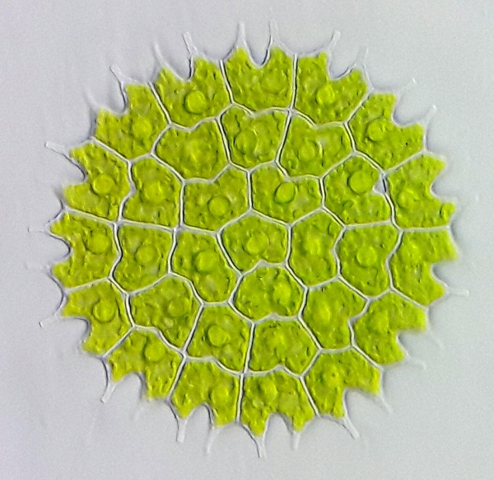
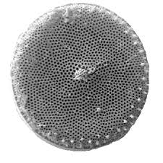
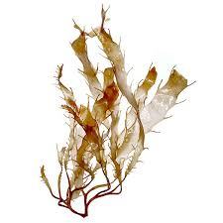
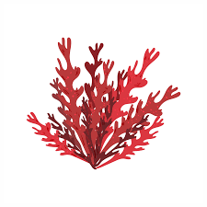
INTRODUCTION TO ALGAE
Sukanya Sarma
Assistant Professor (HoD)
Department of Botany
Salbari College

Slide 2
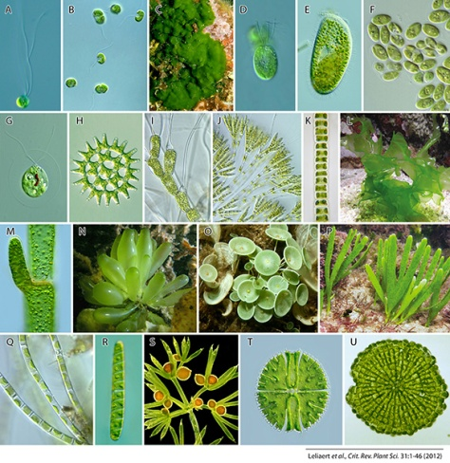
ALGAE
Alga is a name that characterizes a huge and varied group of eukaryotic photosynthetic organisms. They do not have the same ancestor, and might not be related to one another. Good examples of multicellular algae are the massive kelp and brown algae. Euglenophyta, dinoflagellates and diatoms are good examples of unicellular algae.

Slide 3
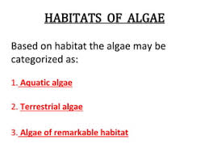
The majority of algae requires a humid or watery environment. Hence, they are prevalent in water bodies or near them. They are like another category of photosynthetic creatures anatomically similar to those that grow on land. Nevertheless, this is where the differences end, as algae do not have the structural components typical of plants, like the true stem, stems, and leaves.

Slide 4
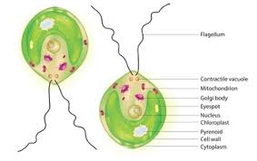
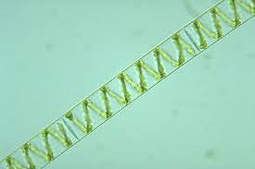
The algae are structurally composed of distinct cell walls, cell membranes, nucleus, the cytoplasm, and the chloroplast. The chloroplast has a cup shape in Chlamydomonas while it is ribbon, like in Spirogyra.
Chlamydomonas
Spirogyra

Slide 5
Characteristics of Algae
Algae can be single-cell organisms or multicellular species.
Because algae lack a well-defined body, they lack structures such as roots, stems and leaves.
Algae are usually photosynthetic organisms, which are able to synthesize their food.
Algae thrive where there is enough moisture.
Asexual and sexual reproduction is also possible in algae. Spores are generated, which are used in asexual reproduction.
Algae are free-living organisms that can create symbiotic relationships with other organisms.

Slide 6
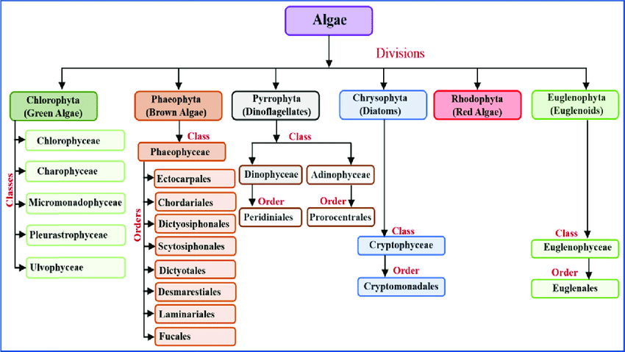
CLASSIFICATION OF ALGAE

Slide 7
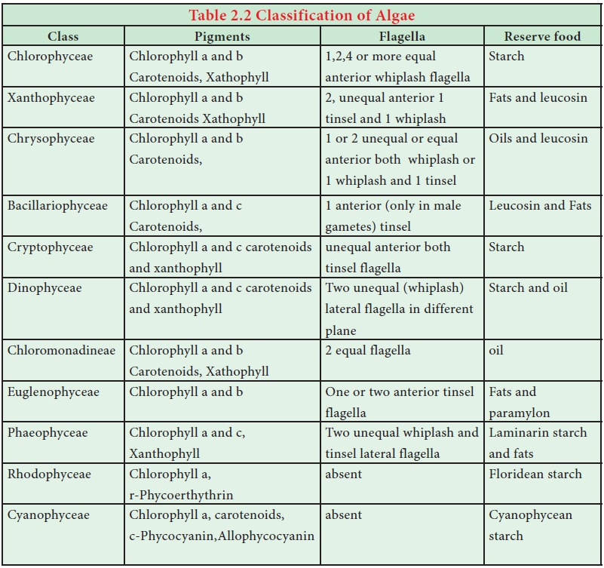

Slide 8
Green Algae

