Slide 1
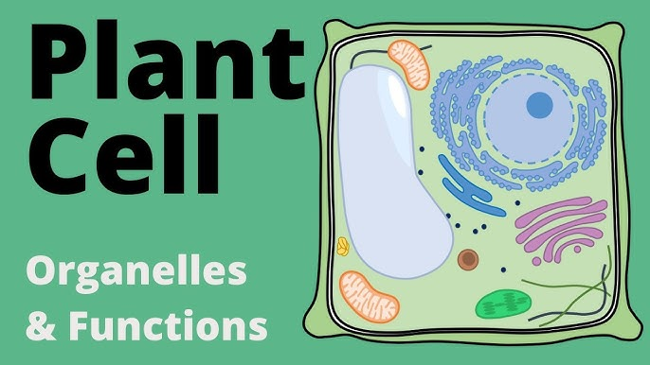
Sukanya Sarma
Assistant Professor (HoD)
Department of Botany
Salbari College

Slide 2
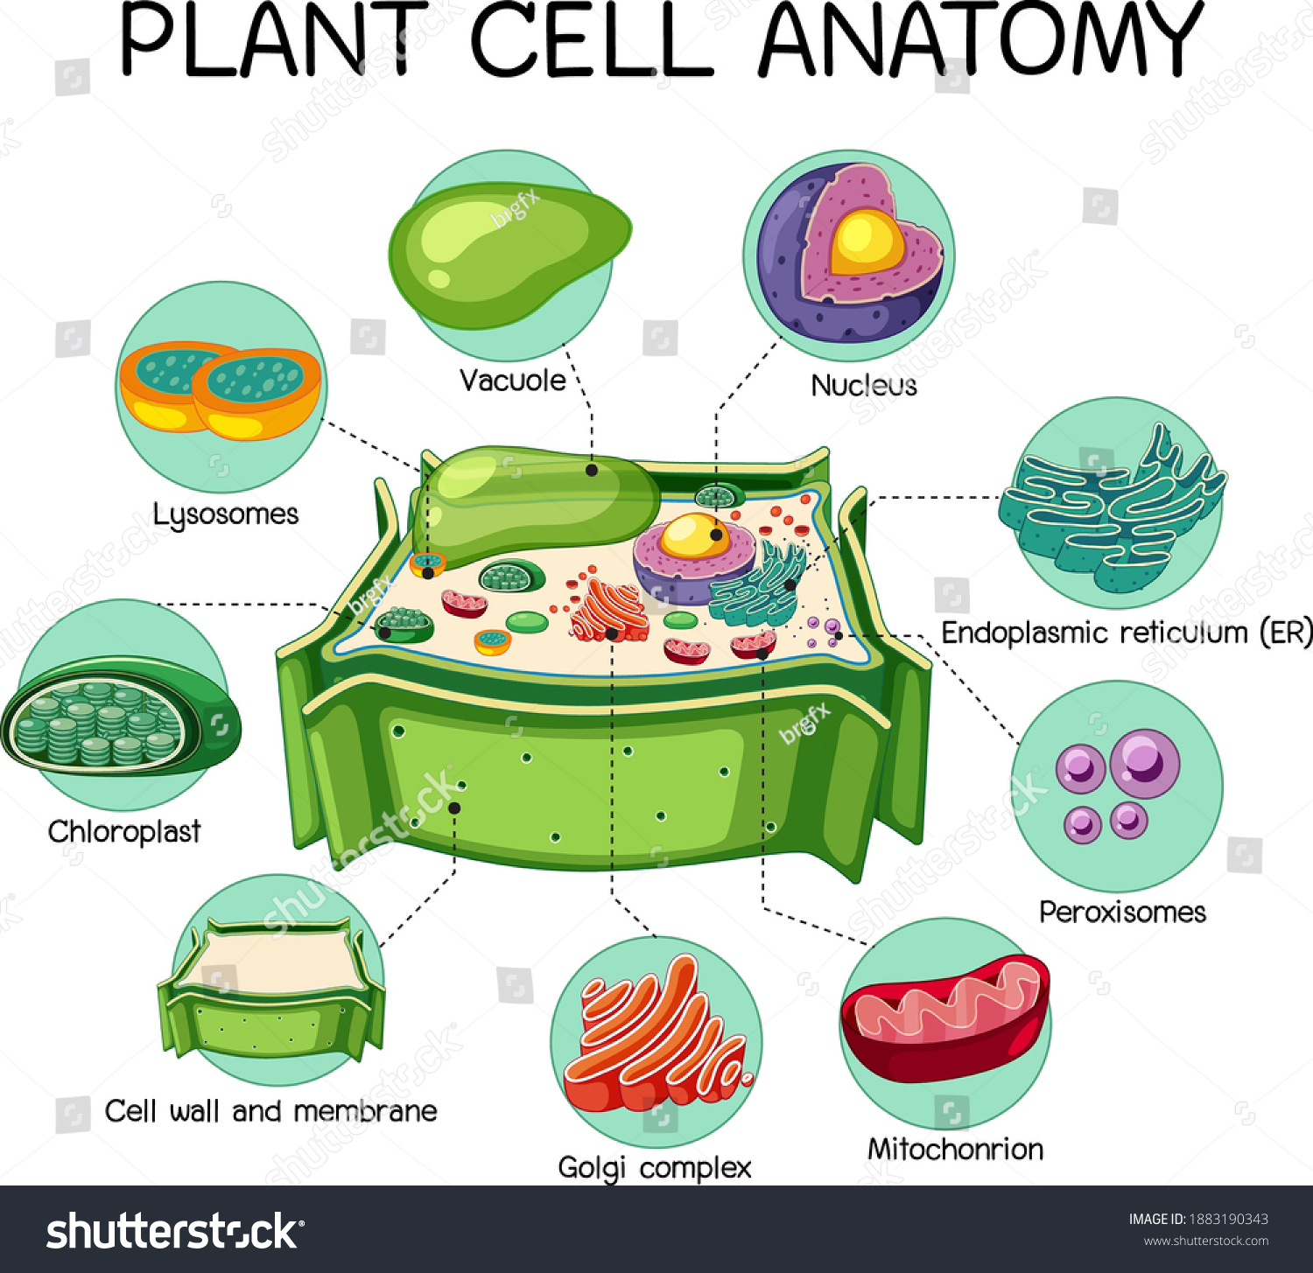

Slide 3
CHLOROPLAST
Plants form the basis of all life on earth and are known as producers. Plant cells contain structures known as plastids which are absent in animal cells. These plastids are double-membraned cell organelles which play a primary role in the manufacturing and storing of food. There are three types of plastids –
Chromoplasts- They are the colour plastids, found in all flowers, fruits and are mainly responsible for their distinctive colours.
Chloroplasts- They are green coloured plastids, which comprise green-coloured pigments within the plant cell and are called chlorophyll.
Leucoplasts- They are colourless plastids and are mainly used for the storage of starch, lipids and proteins within the plant cell.

Slide 4
Chloroplasts are found in all green plants and algae. They are the food producers of plants. These are found in mesophyll cells located in the leaves of the plants. They contain a high concentration of chlorophyll that traps sunlight. This cell organelle is not present in animal cells.
Chloroplast has its own extra-nuclear DNA and therefore are semiautonomous, like mitochondria. They also produce proteins and lipids required for the production of chloroplast membrane.

Slide 5
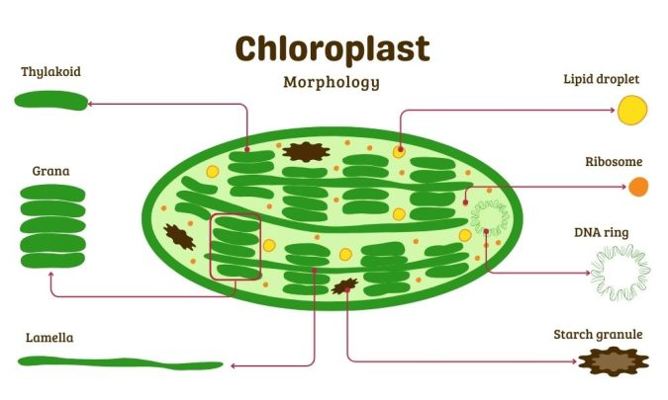
STRUCTURE OF CHLOROPLAST

Slide 6
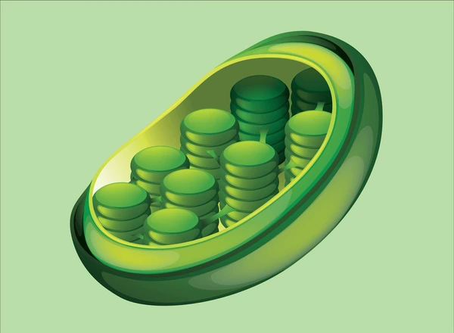
Chloroplasts are found in all higher plants. It is oval or biconvex, found within the mesophyll of the plant cell. The size of the chloroplast usually varies between 4-6 µm in diameter and 1-3 µm in thickness. They are double-membrane organelle with the presence of outer, inner and intermembrane space. There are two distinct regions present inside a chloroplast known as the grana and stroma.
Double membrane

Slide 7
Grana are made up of stacks of disc-shaped structures known as thylakoids or lamellae. The grana of the chloroplast consists of chlorophyll pigments and are the functional units of chloroplasts.
Stroma is the homogenous matrix which contains grana and is similar to the cytoplasm in cells in which all the organelles are embedded. Stroma also contains various enzymes, DNA, ribosomes, and other substances. Stroma lamellae function by connecting the stacks of thylakoid sacs or grana.
The chloroplast structure consists of the following parts:
Membrane Envelope
It comprises inner and outer lipid bilayer membranes. The inner membrane separates the stroma from the intermembrane space.
Intermembrane Space
The space between inner and outer membranes.

Slide 8
Thylakoid System (Lamellae)
The system is suspended in the stroma. It is a collection of membranous sacs called thylakoids or lamellae. The green coloured pigments called chlorophyll are found in the thylakoid membranes. It is the sight for the process of light-dependent reactions of the photosynthesis process. The thylakoids are arranged in stacks known as grana and each granum contains around 10-20 thylakoids.
Stroma
It is a colourless, alkaline, aqueous, protein-rich fluid present within the inner membrane of the chloroplast present surrounding the grana.
Grana
Stack of lamellae in plastids is known as grana. These are the sites of conversion of light energy into chemical energy.

Slide 9
FUNCTION OF CHLOROPLAST
The most important function of the chloroplast is to synthesise food by the process of photosynthesis.
Absorbs light energy and converts it into chemical energy.
Chloroplast has a structure called chlorophyll which functions by trapping the solar energy and is used for the synthesis of food in all green plants.
Produces NADPH and molecular oxygen (O₂) by photolysis of water.
Produces ATP – Adenosine triphosphate by the process of photosynthesis.
The carbon dioxide (CO2) obtained from the air is used to generate carbon and sugar during the Calvin Cycle or dark reaction of photosynthesis.

Slide 10
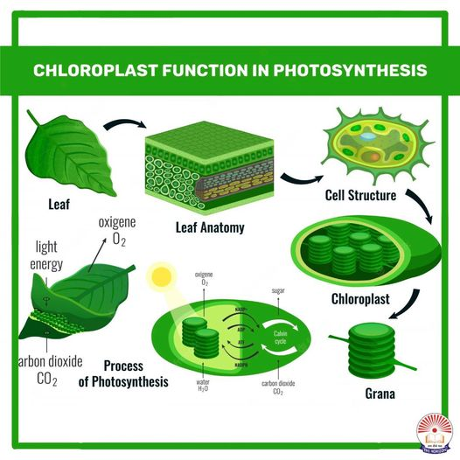

Slide 11
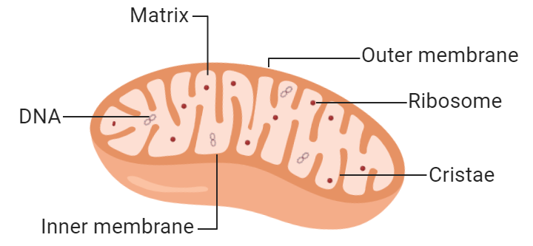
MITOCHONDRIA
Popularly known as the “Powerhouse of the cell,” mitochondria (singular: mitochondrion) are a double membrane-bound organelle found in most eukaryotic organisms. They are found inside the cytoplasm and essentially function as the cell’s “digestive system.”

Slide 12
They play a major role in breaking down nutrients and generating energy-rich molecules for the cell. Many of the biochemical reactions involved in cellular respiration take place within the mitochondria. The term ‘mitochondrion’ is derived from the Greek words “mitos” and “chondrion” which means “thread” and “granules-like”, respectively. It was first described by a German pathologist named Richard Altmann in the year 1890.

Slide 13
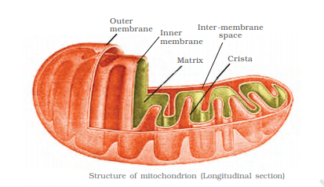

Slide 14
STRUCTURE OF MITOCHONDRIA
The mitochondrion is a double-membraned, rod-shaped structure found in both plant and animal cell.
Its size ranges from 0.5 to 1.0 micrometre in diameter.
The structure comprises an outer membrane, an inner membrane, and a gel-like material called the matrix.
The outer membrane and the inner membrane are made of proteins and phospholipid layers separated by the intermembrane space.
The outer membrane covers the surface of the mitochondrion and has a large number of special proteins known as porins.

Slide 15
Cristae
The inner membrane of mitochondria is rather complex in structure. It has many folds that form a layered structure called cristae, and this helps in increasing the surface area inside the organelle. The cristae and the proteins of the inner membrane aid in the production of ATP molecules. The inner mitochondrial membrane is strictly permeable only to oxygen and ATP molecules. A number of chemical reactions take place within the inner membrane of mitochondria.
Mitochondrial Matrix
The mitochondrial matrix is a viscous fluid that contains a mixture of enzymes and proteins. It also comprises ribosomes, inorganic ions, mitochondrial DNA, nucleotide cofactors, and organic molecules. The enzymes present in the matrix play an important role in the synthesis of ATP molecules.

Slide 16
FUNCTION OF MITOCHONRIA
Regulates the metabolic activity of the cell
Promotes the growth of new cells and cell multiplication
Helps in detoxifying ammonia in the liver cells
Plays an important role in apoptosis or programmed cell death
Responsible for building certain parts of the blood and various hormones like testosterone and oestrogen
Helps in maintaining an adequate concentration of calcium ions within the compartments of the cell
It is also involved in various cellular activities like cellular differentiation, cell signalling, cell senescence, controlling the cell cycle and also in cell growth.

Slide 17
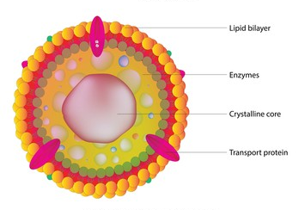
PEROXISOME

Slide 18
Peroxisomes are small vesicles, single membrane-bound organelles found in the eukaryotic cells. They contain digestive enzymes for breaking down toxic materials in the cell and oxidative enzymes for metabolic activity. They are a heterogeneous group of organelles and the presence of the marker enzymes distinguished them from other cell organelles.
Peroxisomes play an important role in lipid production and are also involved in the conversion of reactive oxygen species such as hydrogen peroxide into safer molecules like water and oxygen by the enzyme catalase.
Mostly peroxisomes occur as an individual organelle, e.g. in fibroblasts. They also exist in the form of interconnected tubules in liver cells known as peroxisome reticulum.

Slide 19
STRUCTURE OF PEROXISOME
Peroxisomes vary in shape, size and number depending upon the energy requirements of the cell. These are made of a phospholipid bilayer with many membrane-bound proteins.
The enzymes involved in lipid metabolism are synthesised on free ribosomes and selectively imported to peroxisomes. These enzymes include one of the two signalling sequences- Peroxisome Target Sequence 1 being the most common one.
The phospholipids of peroxisomes are usually synthesised in smooth Endoplasmic reticulum. Due to the ingress of proteins and lipids, the peroxisome grows in size and divides into two organelles.
Peroxisomes do not have their own DNA. Proteins are transported from the cytosol after translation.

Slide 20
FUNCTION OF PEROXISOME
The main function of peroxisome is the lipid metabolism and the processing of reactive oxygen species. Other peroxisome functions include:
They take part in various oxidative processes.
They take part in lipid metabolism and catabolism of D-amino acids, polyamines and bile acids.
The reactive oxygen species such as peroxides produced in the process is converted to water by various enzymes like peroxidase and catalase.
In plants, peroxisomes facilitate photosynthesis and seed germination. They prevent loss of energy during photosynthesis carbon fixation.

Slide 21
