Slide 1
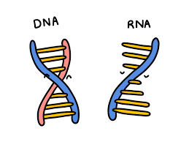
NUCLEIC ACIDS
Sukanya Sarma
Assistant Professor (HoD)
Department of Botany
Salbari College

Slide 2
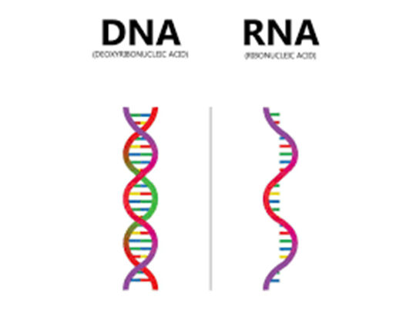
What are nucleic acids?
Nucleic acids are long-chain polymeric molecules, the monomer (the repeating unit) is known as the nucleotides and hence sometimes nucleic acids are referred to as polynucleotides.
Deoxyribonucleic acid (DNA) and ribonucleic acid (RNA) are two major types of nucleic acids. DNA and RNA are responsible for the inheritance and transmission of specific characteristics from one generation to the other. There are prominently two types of nucleic acids known to us.

Slide 3
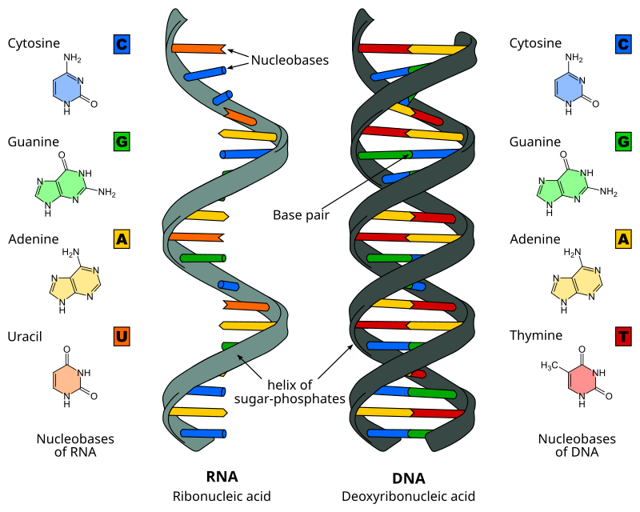

Slide 4
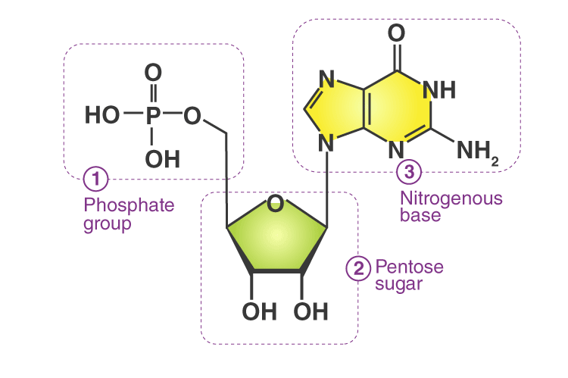
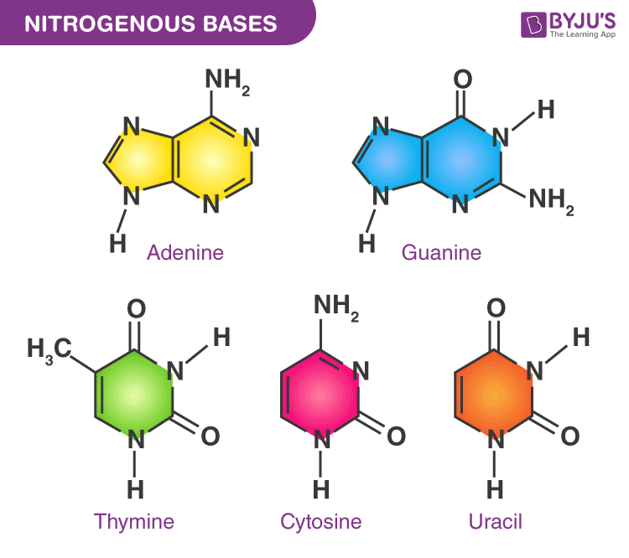
Nitrogenous bases

Slide 5
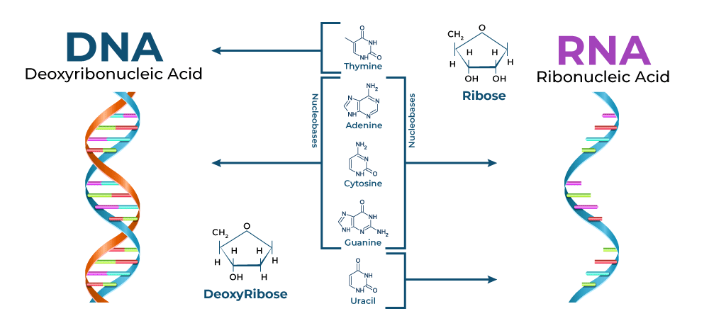

Slide 6
The Functions of Nucleic Acids
Nucleic acids are responsible for the transmission of inherent characters from parent to offspring.
They are responsible for the synthesis of protein in our body.
DNA fingerprinting is a method used by forensic experts to determine paternity. It is also used for the identification of criminals. It has also played a major role in studies regarding biological evolution and genetics.

Slide 7
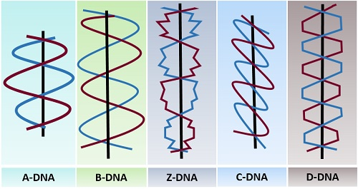
TYPES OF DNA

